Slide 1
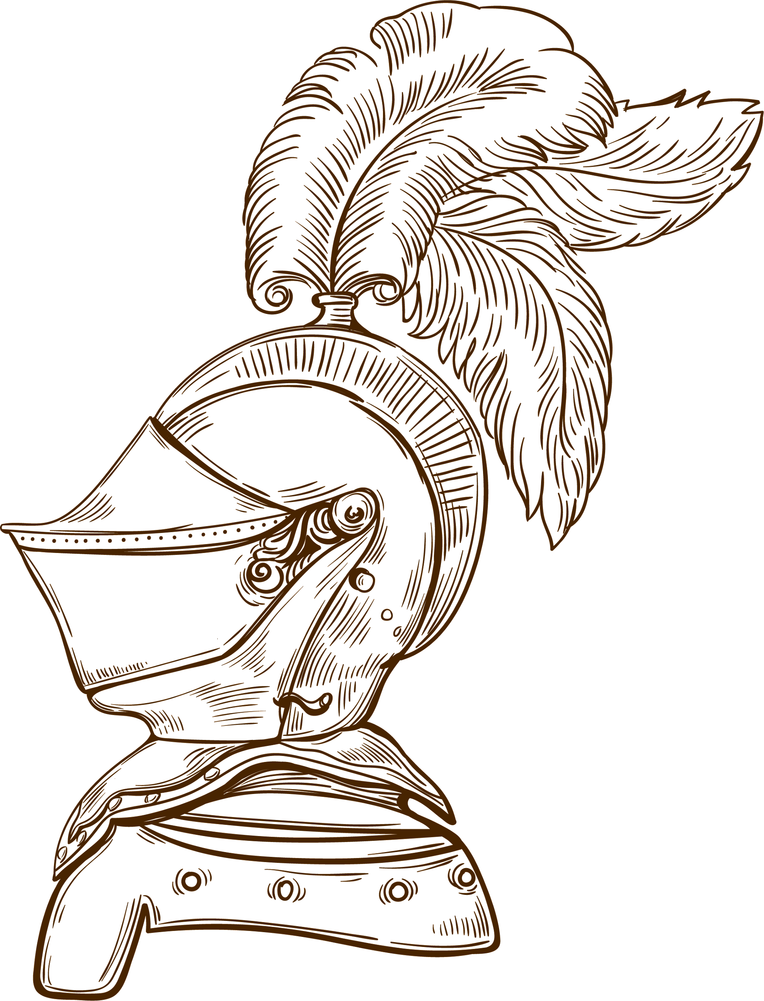
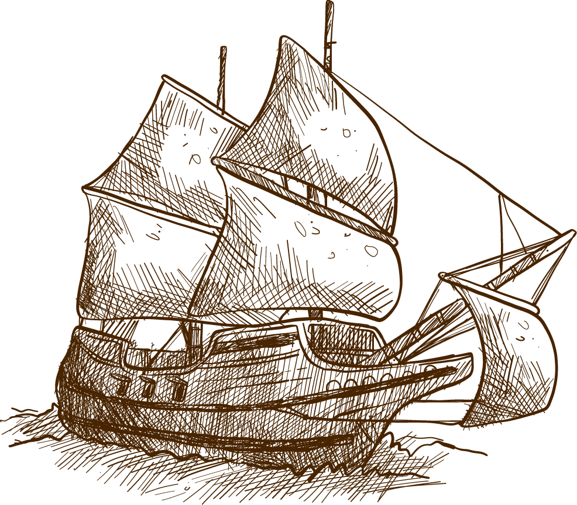

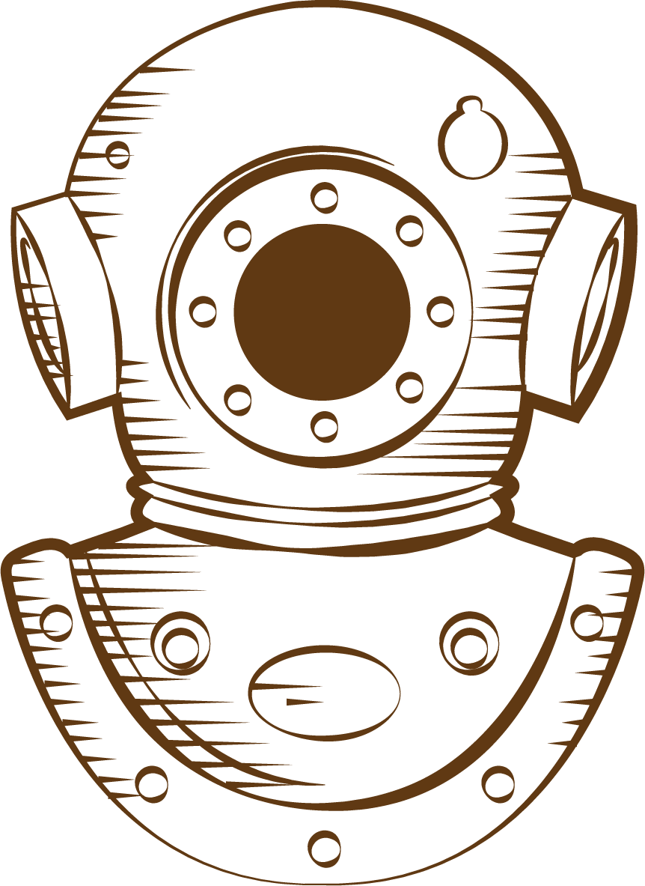
Language
History

Slide 2
CONTENTS OF THIS TEMPLATE
Here’s what you’ll find in this Slidesgo template:
A slide structure based on a lesson, which you can easily adapt to your needs. For more info on how to edit the template, please visit Slidesgo School or read our FAQs.
To view this template in PowerPoint with the correct fonts, download and install on your computer the fonts that we have used. You can learn how to download and install fonts here.
An assortment of resources that are suitable for use in the presentation can be found in the alternative resources slides.
A thanks slide, which you must keep so that proper credits for our design are given.
Two resources slides, where you’ll find links to all the elements used in the template.
Instructions for use.
Final slides with:
The fonts and colors used in the template.
A selection of illustrations. You can also customize and animate them as you wish with the online editor. Visit Storyset to find more.
More infographic resources, whose size and color can be edited.
Sets of customizable icons of the following themes: general, business, avatar, creative process, education, help & support, medical, nature, performing arts, SEO & marketing, and teamwork.
You can delete this slide when you’re done editing the presentation.

Slide 3
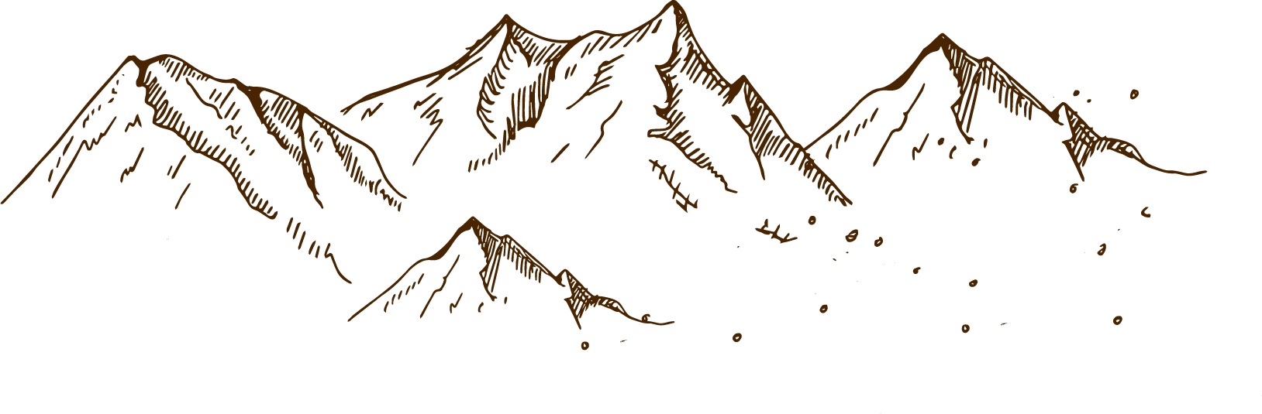
01
03
OVERVIEW
ASSIGNMENT
02
FEATURES OF THE TOPIC
04
ABOUT THE TOPIC

Slide 4
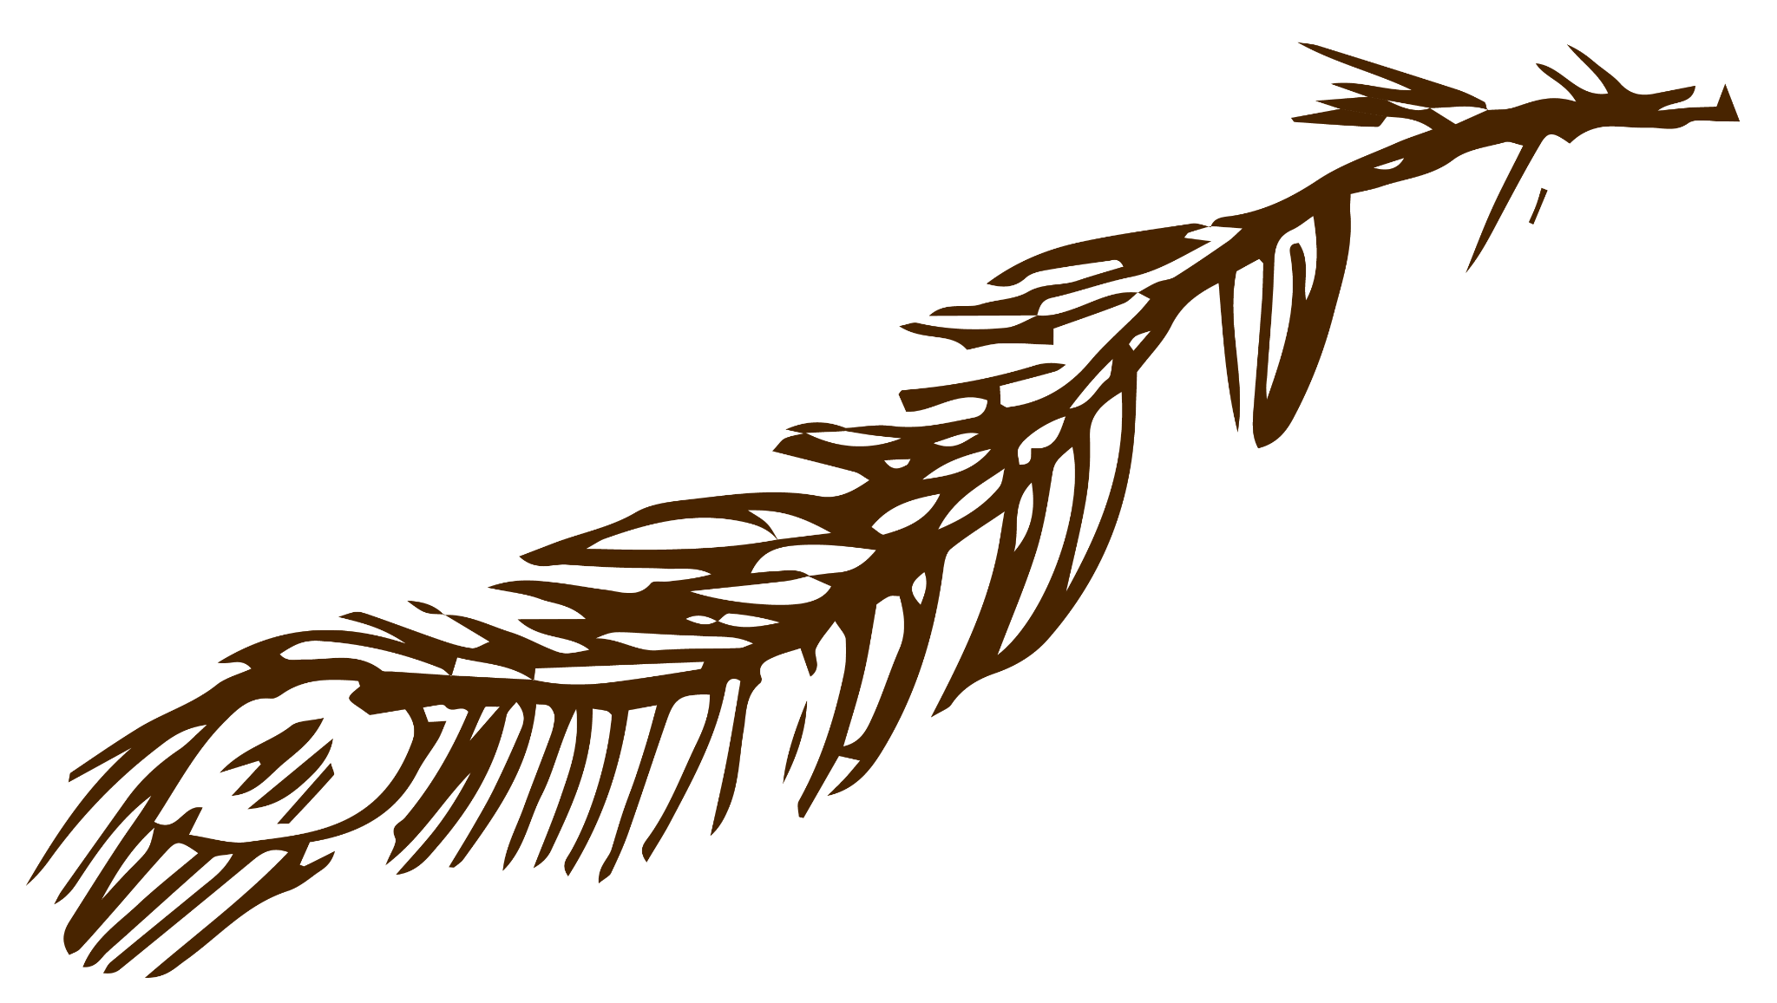
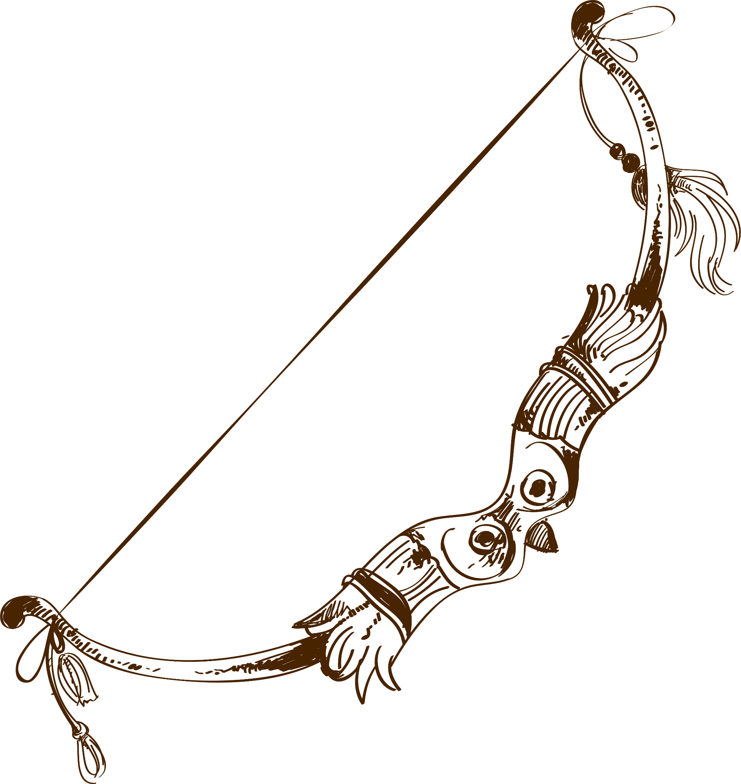
01
OVERVIEW
You can enter a subtitle here if you need it

Slide 5
—SOMEONE FAMOUS
“This is a quote, words full of wisdom that someone important said and can make the reader get inspired.”

Slide 6
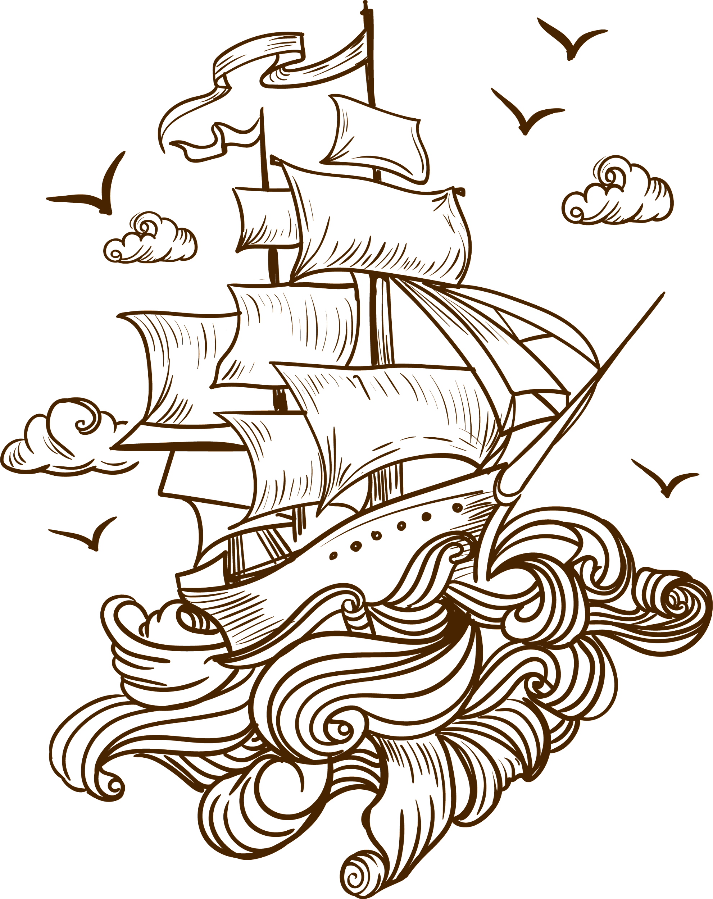
INTRODUCTION
Venus has a beautiful name and is the second planet from the Sun. It’s terribly hot—even hotter than Mercury—and its atmosphere is extremely poisonous

Slide 7
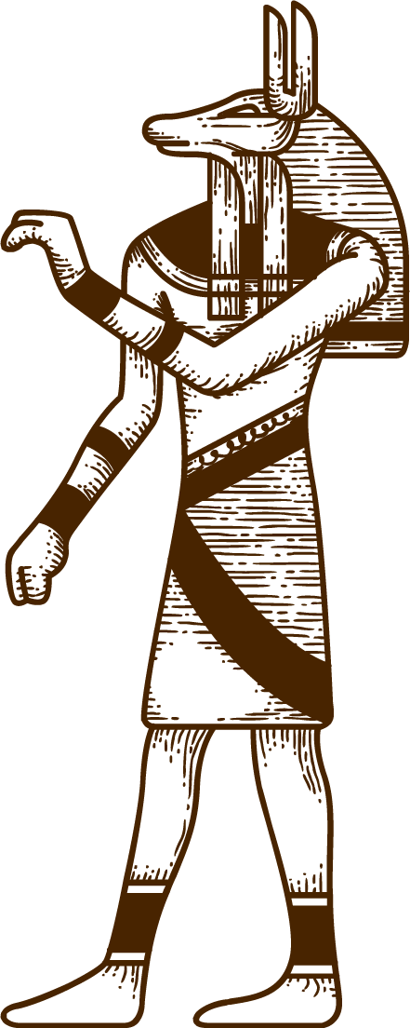
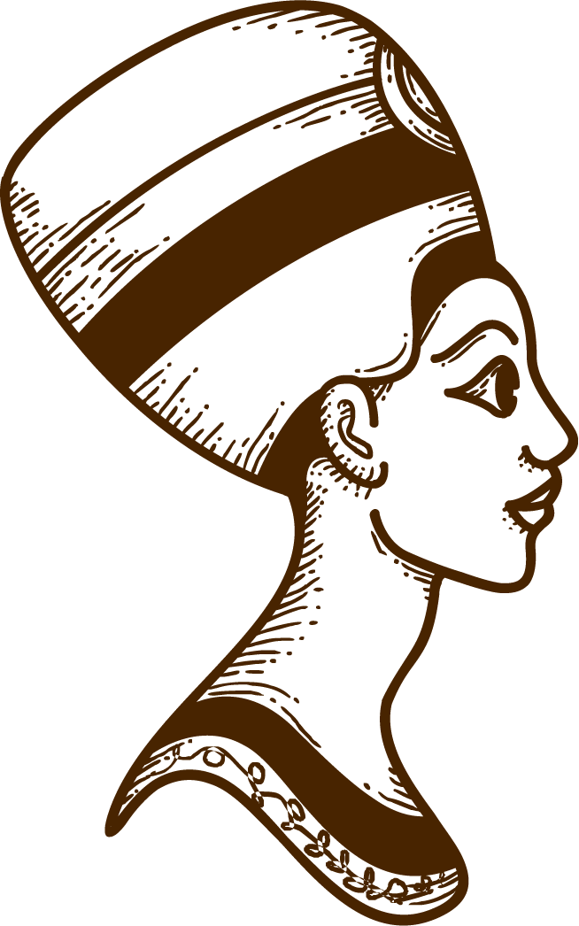
WHAT IS THIS TOPIC ABOUT?
MARS
Despite being red, Mars is actually a cold place. It’s full of iron oxide dust, which is what gives the planet its reddish cast
VENUS
Venus has a beautiful name and is the second planet from the Sun. It’s terribly hot, more than Mercury, which is closer to the Sun

Slide 8
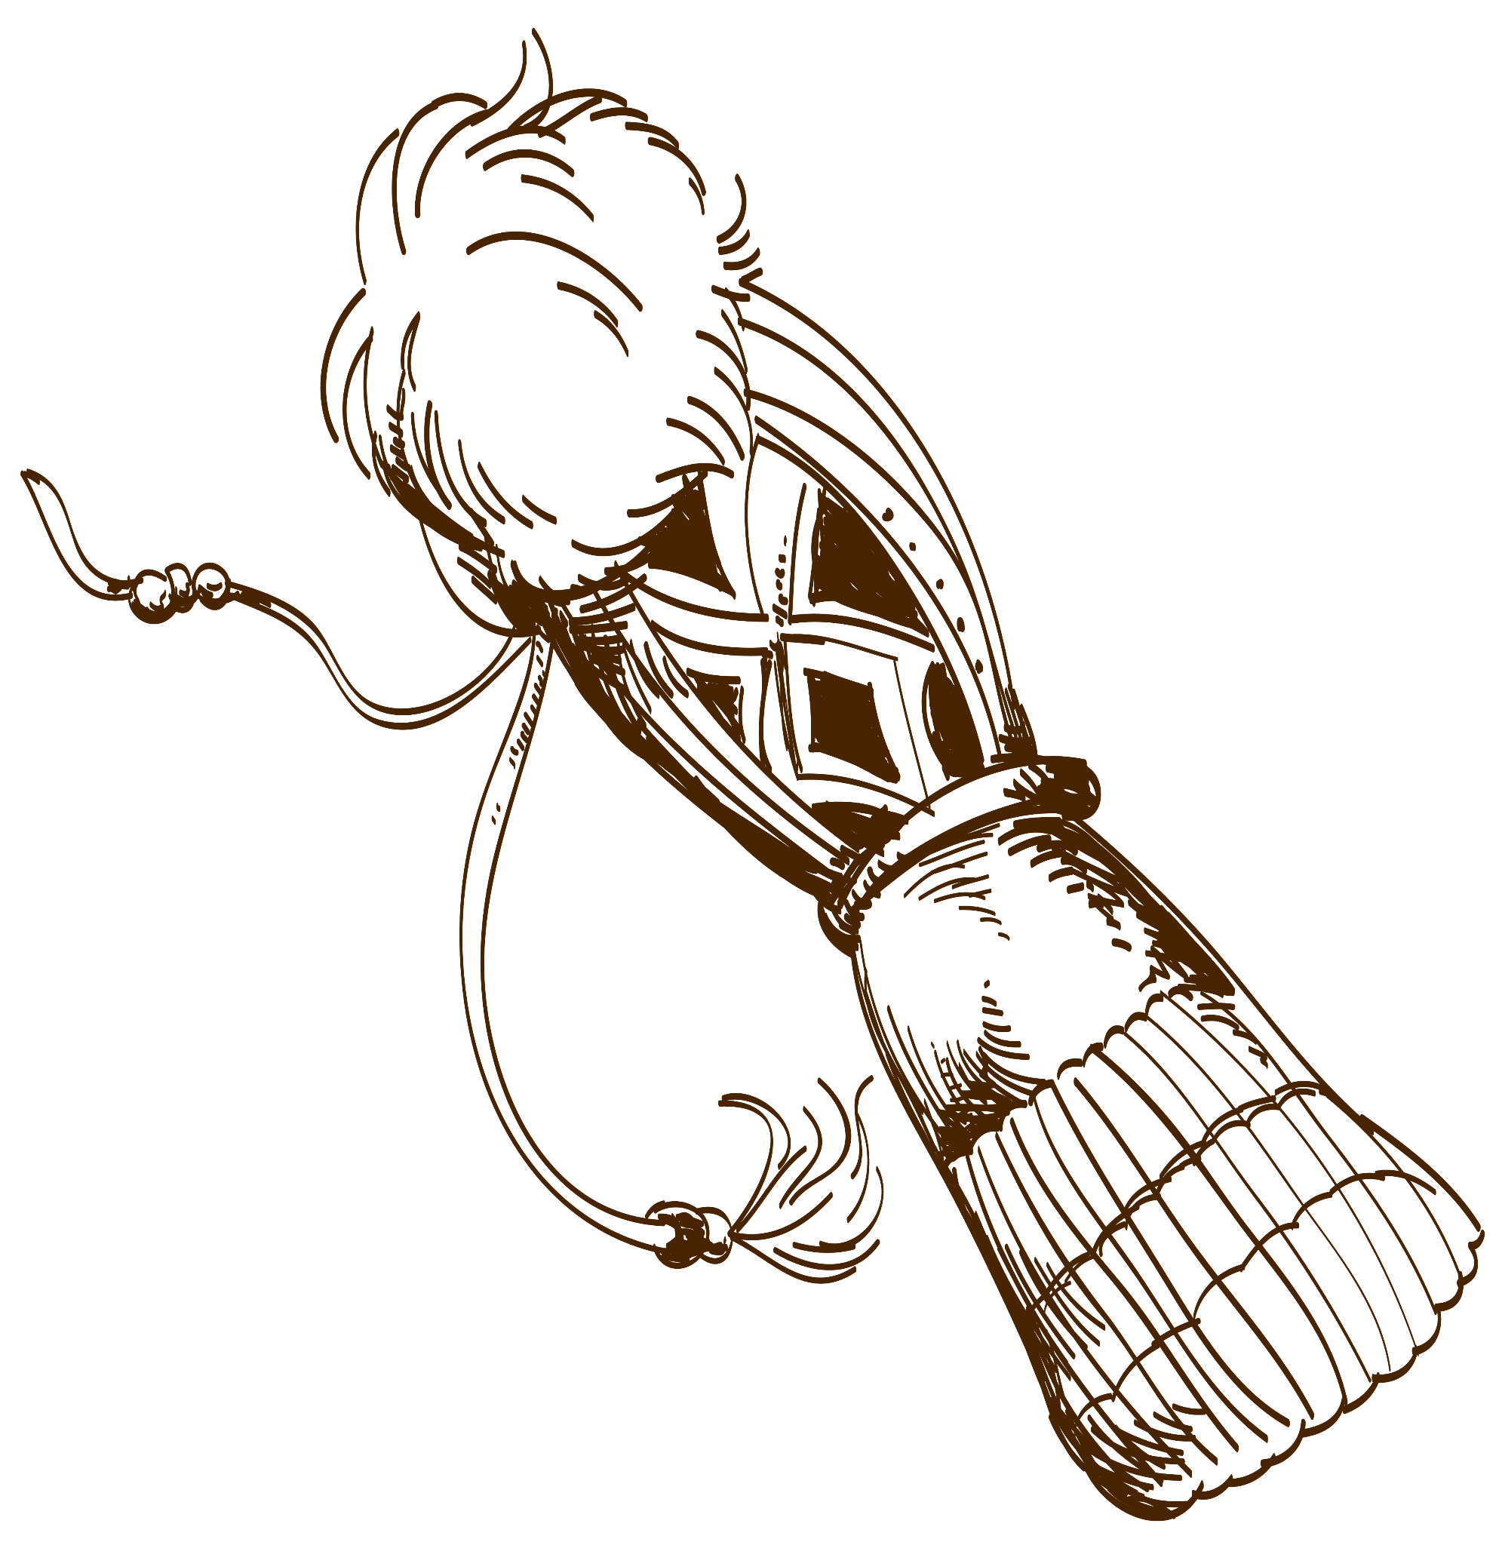
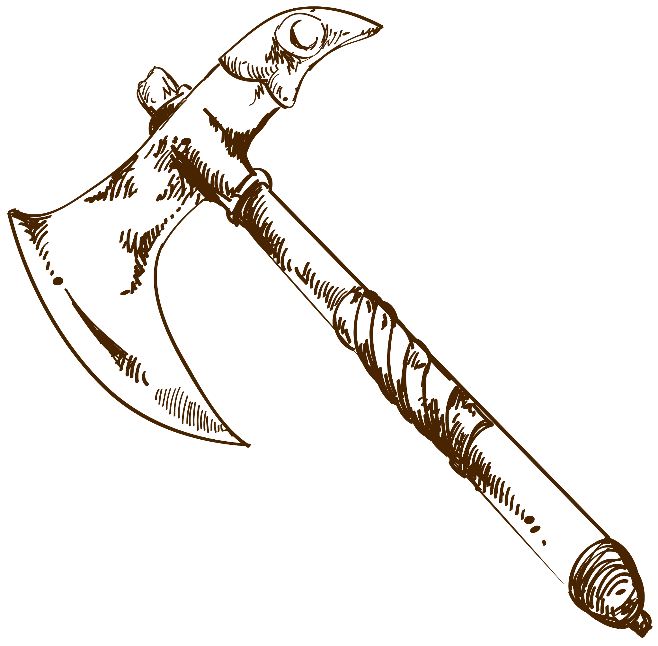
THE TWO MAIN TOPICS
MARS
VENUS
Despite being red, Mars is actually a cold place. It’s full of iron oxide dust, which gives the planet its reddish cast
Venus has a beautiful name and is the second planet from the Sun. It’s terribly hot, even hotter than Mercury

Slide 9
THE ORIGINS OF PAPYRUS
VENUS
MERCURY
MARS
It has a beautiful name and is the second planet from the Sun
It’s the closest planet to the Sun and the smallest in the Solar System
Despite being red, Mars is actually a cold place. It’s full of iron oxide dust

Slide 10

DEFINITION OF CONCEPTS
01
02
03
04
MERCURY
MARS
NEPTUNE
SATURN
Mercury is the smallest planet in the Solar System
Despite being red, Mars is actually a cold place
Neptune is the fourth-largest planet in the Solar System
Saturn is composed mostly of hydrogen and helium

Slide 11
A SHORT SUMMARY OF THE TOPIC
HISTORY
ETYMOLOGY
DOCUMENTS
ITS USE
Saturn is a gas giant and has several rings
Despite being red, Mars is a cold place
Jupiter is the biggest planet of them all
Venus is the second planet from the Sun

Slide 12
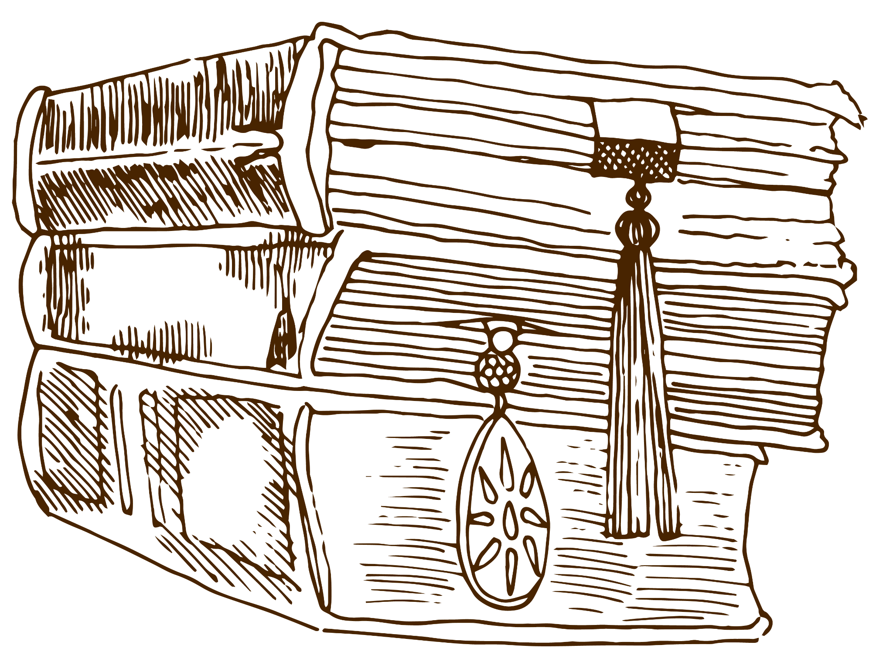
HISTORY
Do you know what helps you make your point clear?
Lists like this one:
They’re simple
You can organize your ideas clearly
You’ll never forget to buy milk!
And the most important thing: the audience won’t miss the point of your presentation

Slide 13
ETYMOLOGY
“PAPYROS”
Venus is the second planet from the Sun
GREEK
EGYPT
Ceres is located in the main asteroid belt
Saturn was named after a Roman god
“ΠΆΠΥΡΟΣ”
“WADJ OR DJIET”

Slide 14

DOCUMENTS
01
03
02
04
NEPTUNE
JUPITER
Neptune is far away from us
Jupiter doesn’t have a solid surface
SATURN
MARS
Saturn was named after a Roman god
Despite being red, Mars is very cold

Slide 15
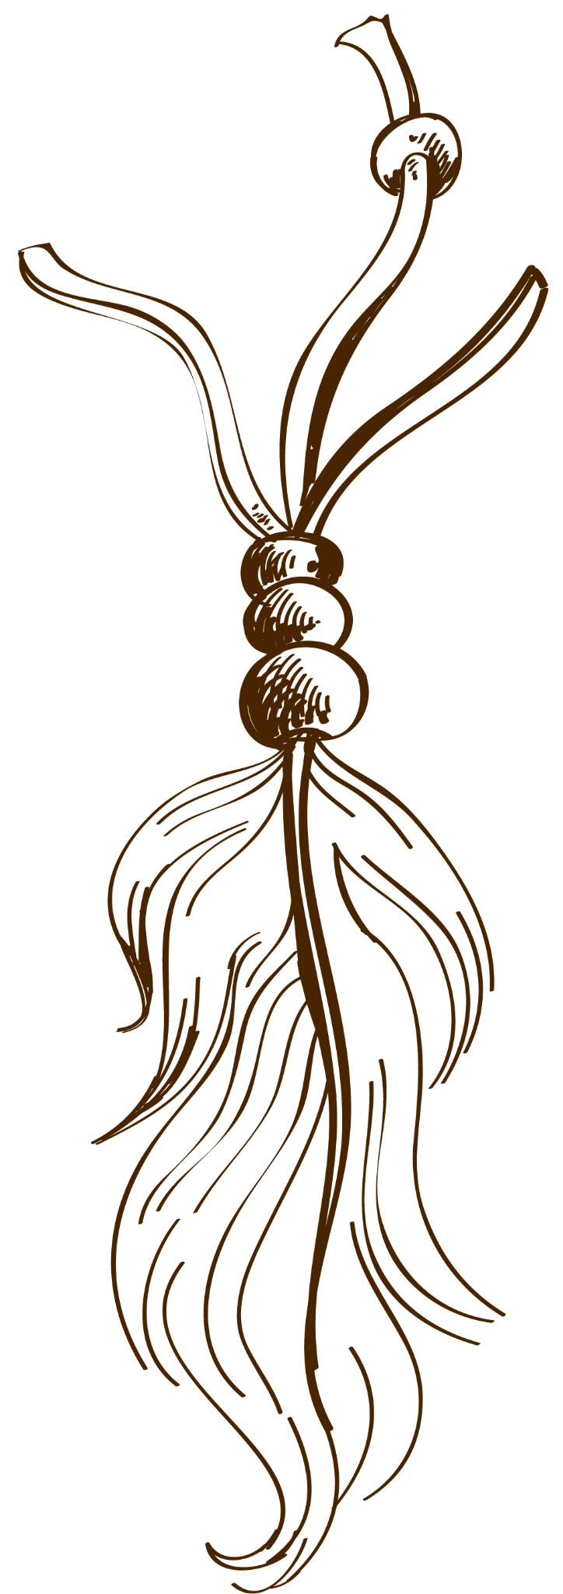
ITS USE
ART
WRITING
Mercury is the closest planet to the Sun
Venus is the second planet from the Sun

Slide 16
IT IS TRUE OR FALSE?
Mark true or false in the following sentences. Look at the first examples:
TRUE | FALSE | Venus is extremely hot, even more than Mercury
TRUE | FALSE | Earth is the only planet known to harbor life
TRUE | FALSE | Despite being red, Mars is very cold
TRUE | FALSE | Jupiter is the biggest planet in the Solar System
TRUE | FALSE | Saturn is a gas giant and has several rings
TRUE | FALSE | Neptune is very far away from the Sun

Slide 17
OTHER ANCIENT AND MODERN USES
ANCIENT USES
MODERN USES
MERCURY | Mercury is the smallest planet of them all
VENUS | Venus is extremely hot, even more than Mercury
EARTH | Earth is the planet where we all live on
MARS | Despite being red, Mars is actually a cold place
SATURN | Saturn is a gas giant and has several rings
NEPTUNE | Neptune is the farthest planet from the Sun
PLUTO | Pluto is now considered a dwarf planet
MOON | The Moon is Earth’s only natural satellite

Slide 18
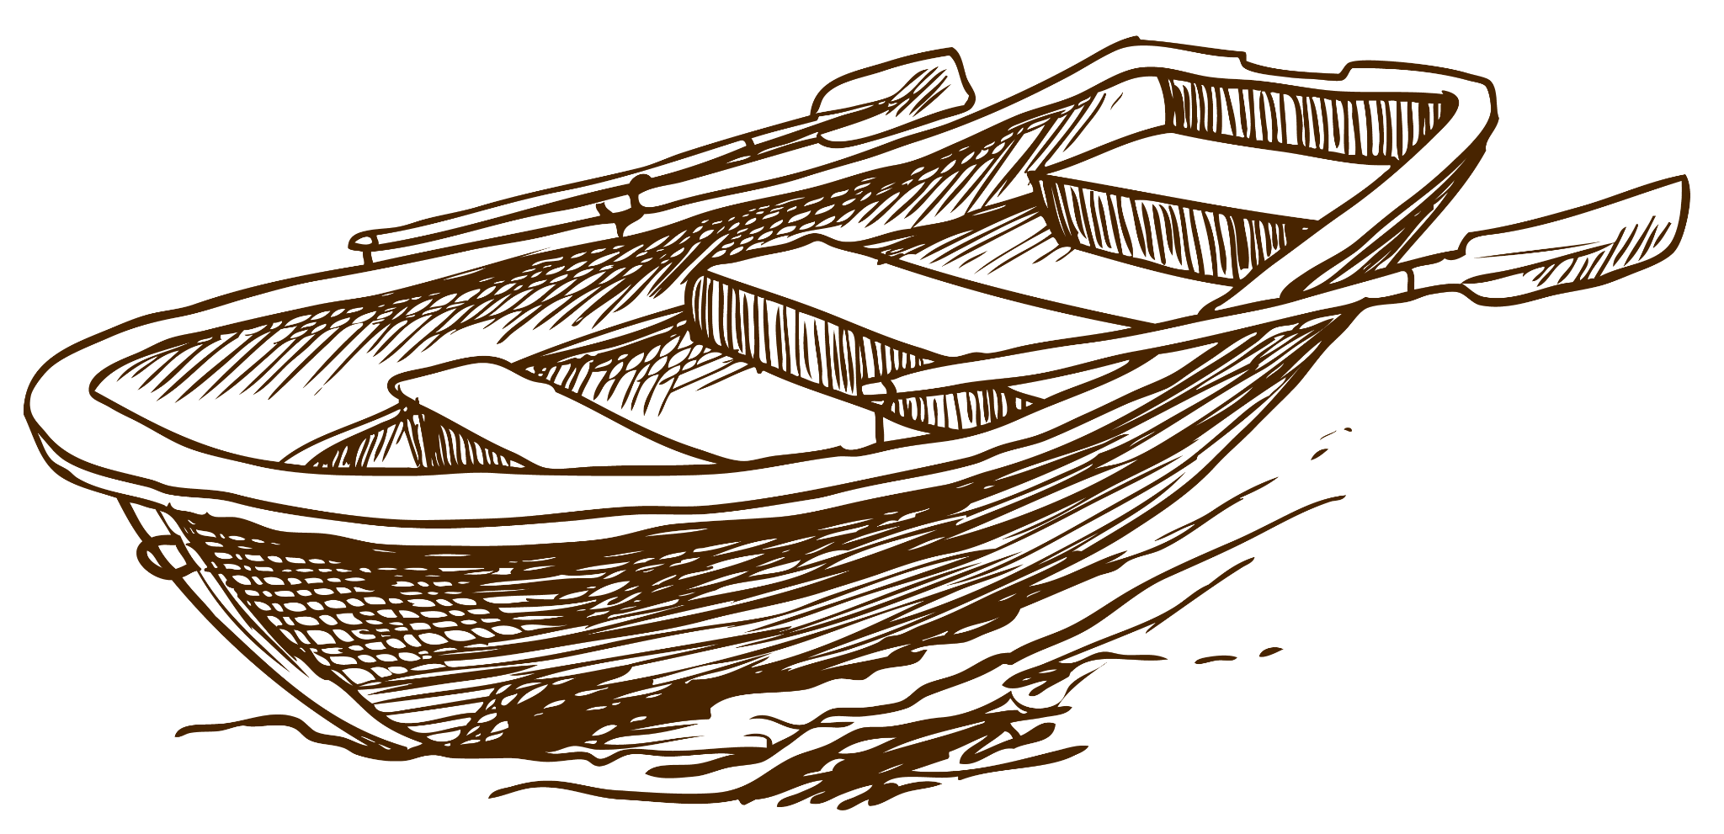
FEATURES OF THE TOPIC
02
You can enter a subtitle here if you need it

Slide 19
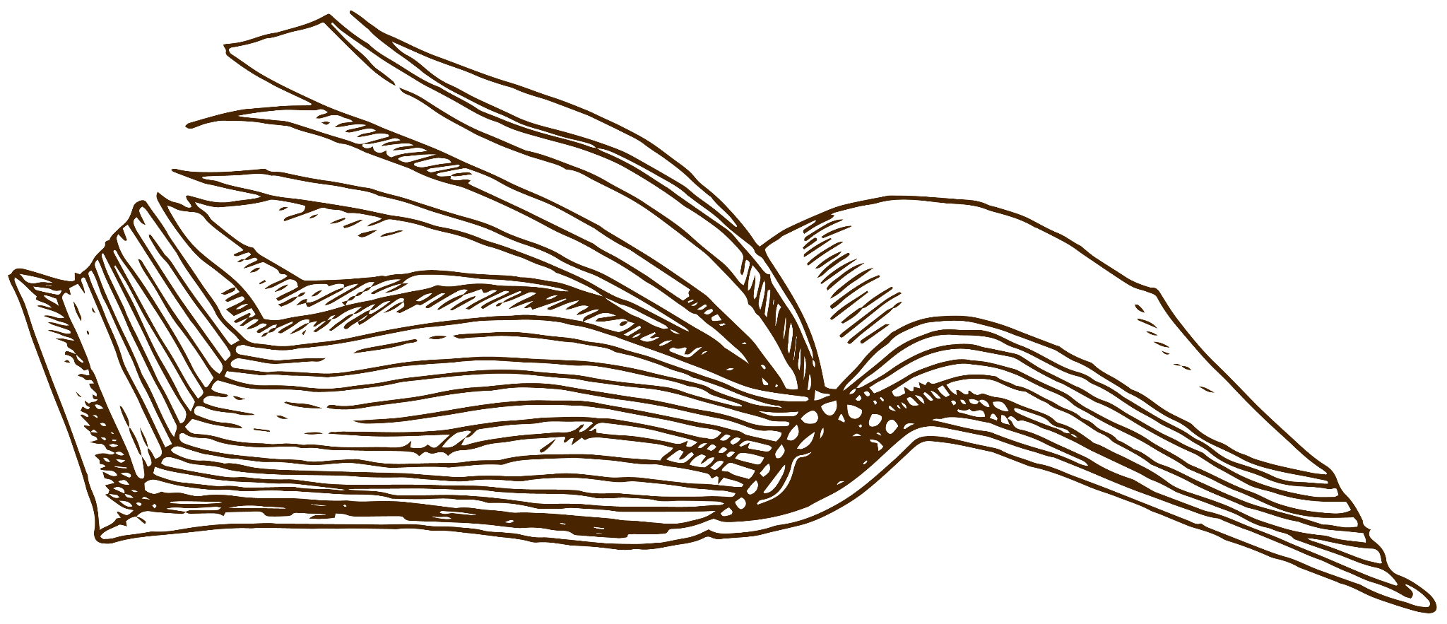
EIGHT ESSENTIAL CONCEPTS
THE MOON
NEPTUNE
EARTH
JUPITER
VENUS
CERES
MARS
SATURN
The Moon is Earth’s only natural satellite
Neptune is far away from us
Earth is the planet where we all live on
Jupiter doesn’t have a solid surface
Venus is the second planet from the Sun
Ceres is located in the asteroid belt
Despite being red, Mars is very cold
Saturn was named after a Roman god

Slide 20
FILL THE TABLE WITH DATA
PEOPLE
BUILDINGS
MATERIALS
TRADITIONS
3000 BC
2000 BC
1300 BC
51 BC
—
Jupiter is the biggest planet
Earth is the planet with life
—
—
—
—
Venus has a beautiful name
Mercury is very small planet
—
Neptune is far away from us
Mars is actually a cold place
Saturn has beautiful rings
Pluto is now a dwarf planet
—
—

Slide 21
CHOOSE THE CORRECT ANSWER
1.
HOW WAS PAPER MADE?
2.
WHERE WAS PAPER INVENTED?
A.
Neptune is far away from us
A.
Mars is a red planet
B.
Saturn is a gas giant
B.
Saturn has rings
3.
WHEN DID WRITING APPEAR?
4.
WHAT ARE THE MAIN USES OF PAPER?
A.
Venus has beautiful rings
A.
Earth has life
B.
Mars is made of basalt
B.
Venus is a hot planet

Slide 22
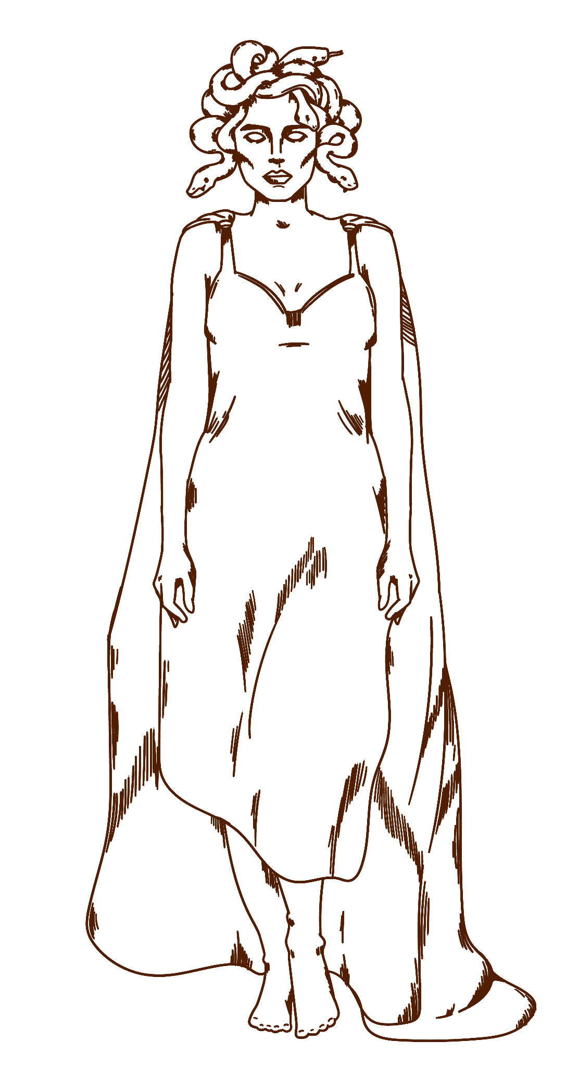
3150 BC
Big numbers catch your audience’s attention

Slide 23
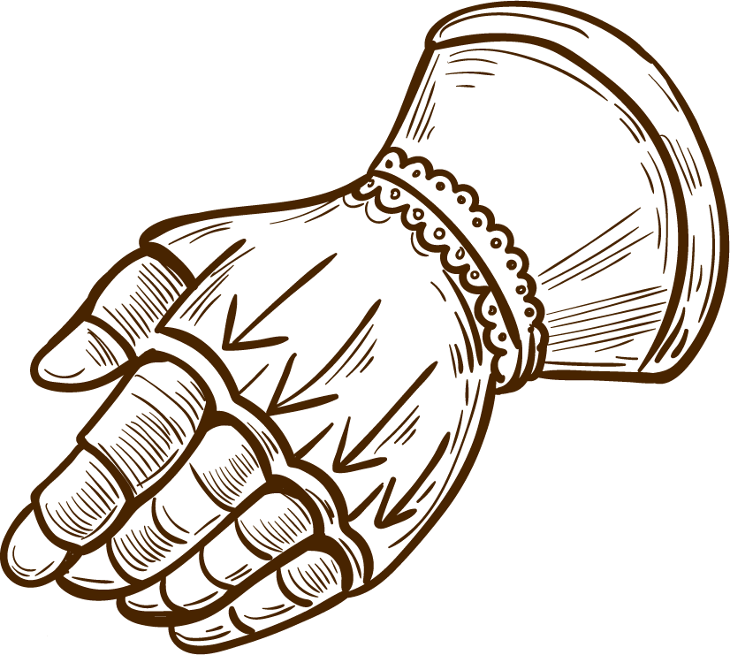
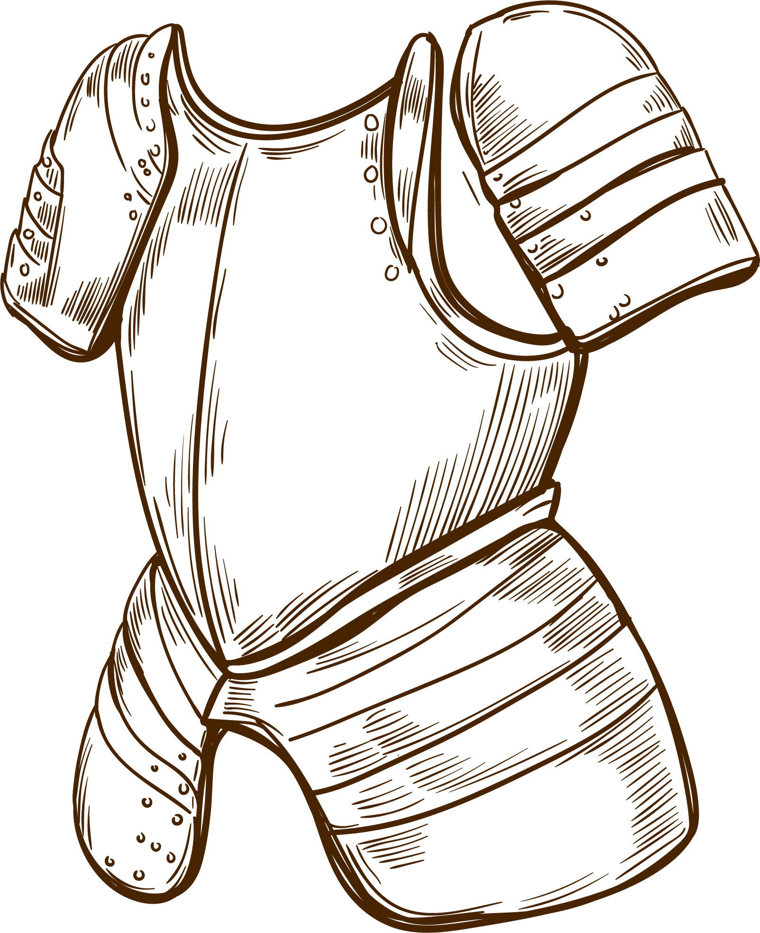
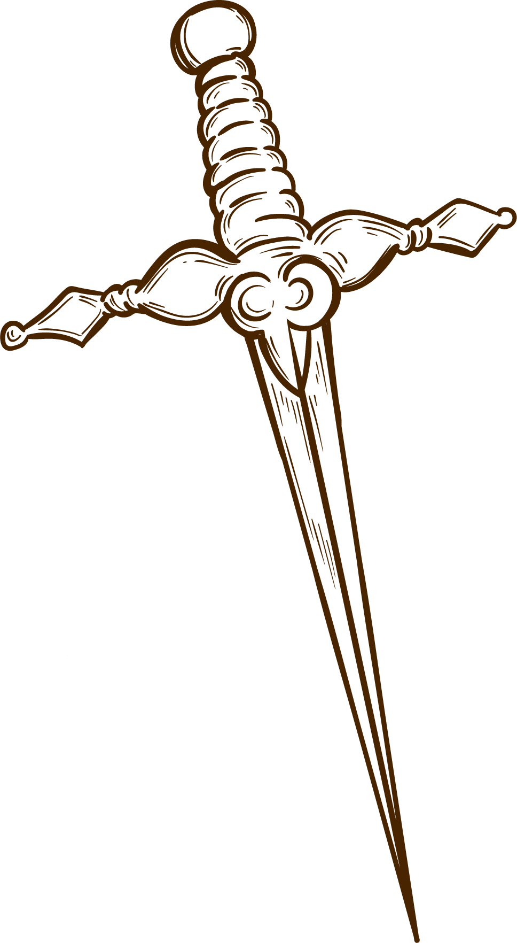
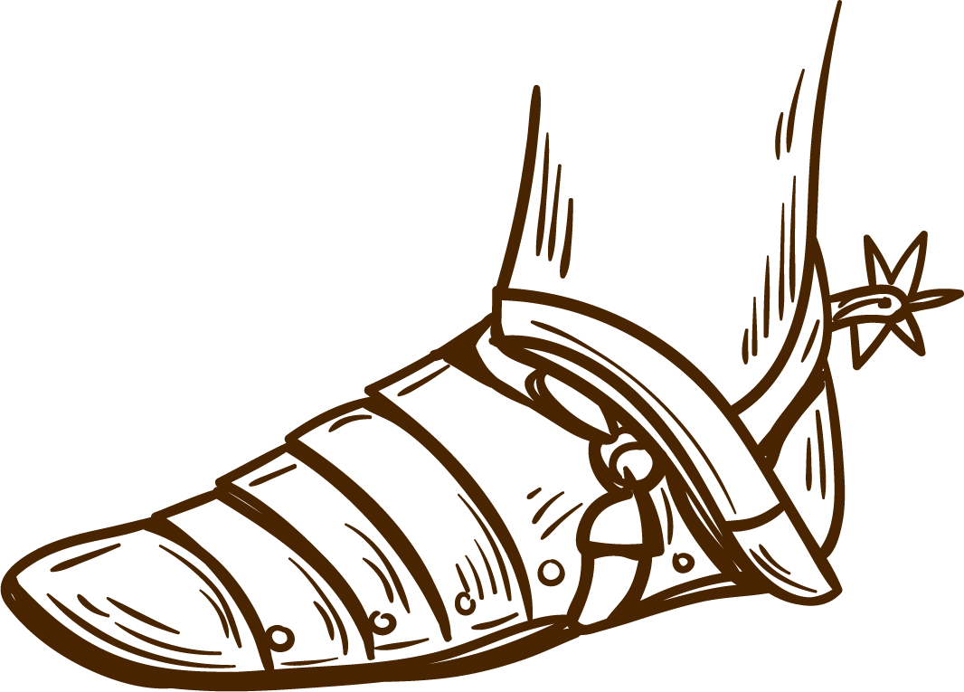
FEATURES OF THE TOPIC
MARS
01
JUPITER
03
MERCURY
02
VENUS
04
Despite being red, Mars is a cold place
It’s the biggest planet in the Solar System
It’s the closest planet to the Sun
Venus is the second planet from the Sun

Slide 24
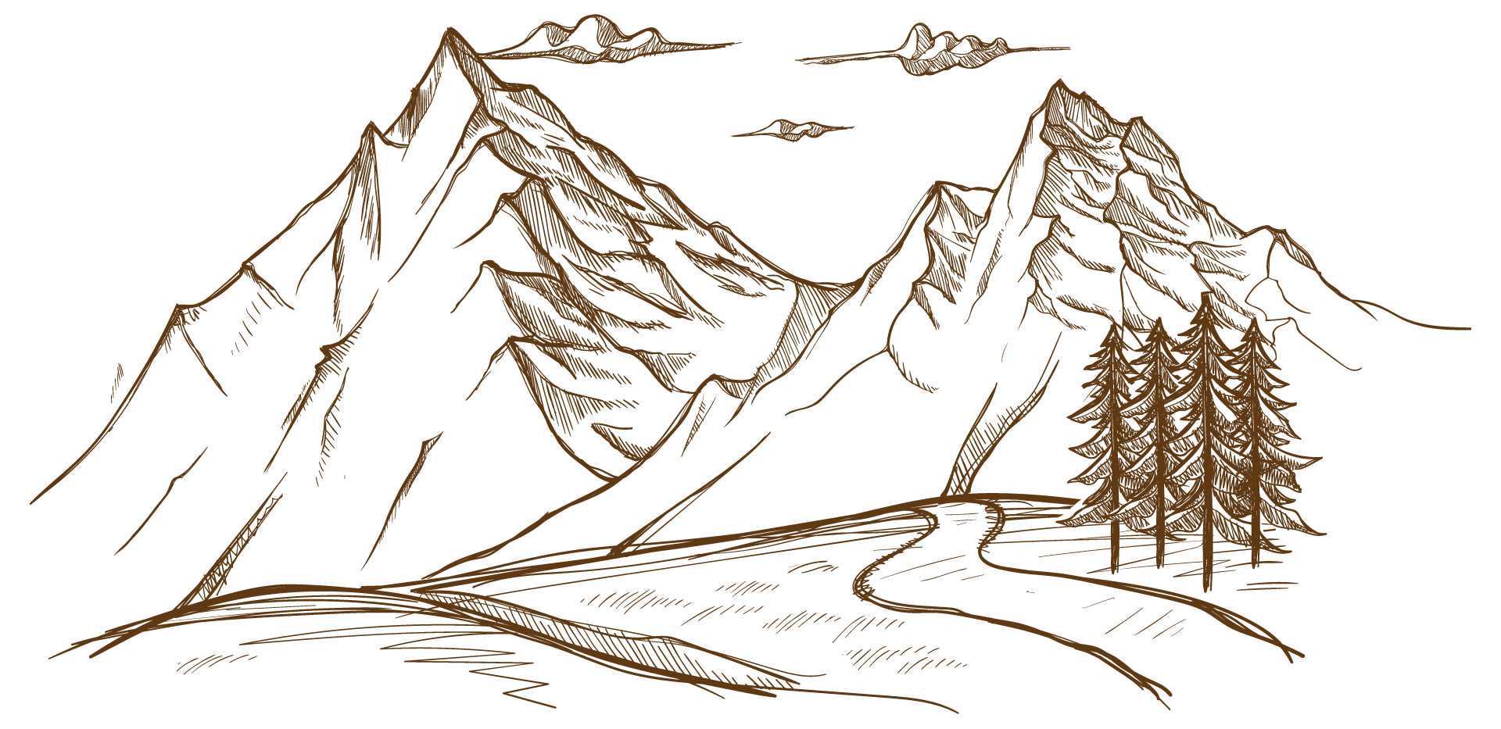
1346
1453
1564
The plague arrives in England
The fall of Constantinople to the Ottoman
William Shakespeare is born

Slide 25
THE FIRST IMPORTANT CULTURES
01
Despite being red, Mars is actually a cold place
MESOPOTAMIA
Jupiter is the biggest planet in the Solar System
02
EGYPT
03
Saturn is a gas giant and has several rings
GREECE

Slide 26
25%
45%
30%
JUPITER
Jupiter is quite a big planet
EARTH
Earth harbors lots of life
THE MOON
It’s Earth’s only natural satellite

Slide 27
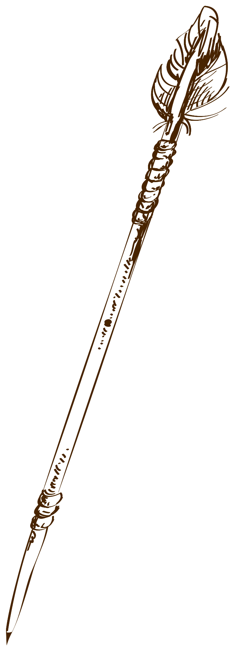
REVIEW THE MOST IMPORTANT DATES
4000 BC
476 AD
1492 AD
1789 AD
SATURN
NEPTUNE
VENUS
JUPITER
Saturn was named after a Roman god
Neptune is very far away from us
Venus is the second planet from the Sun
Jupiter doesn’t have a solid surface

Slide 28
PRACTICAL USES OF THIS SUBJECT
MERCURY
MARS
SATURN
VENUS
NEPTUNE
JUPITER
Mercury is the closest planet to the Sun
Despite being red, Mars is a cold place
Saturn is a gas giant and has several rings
Venus is the second planet from the Sun
Neptune is the farthest planet from the Sun
It’s the biggest planet in the Solar System

Slide 29
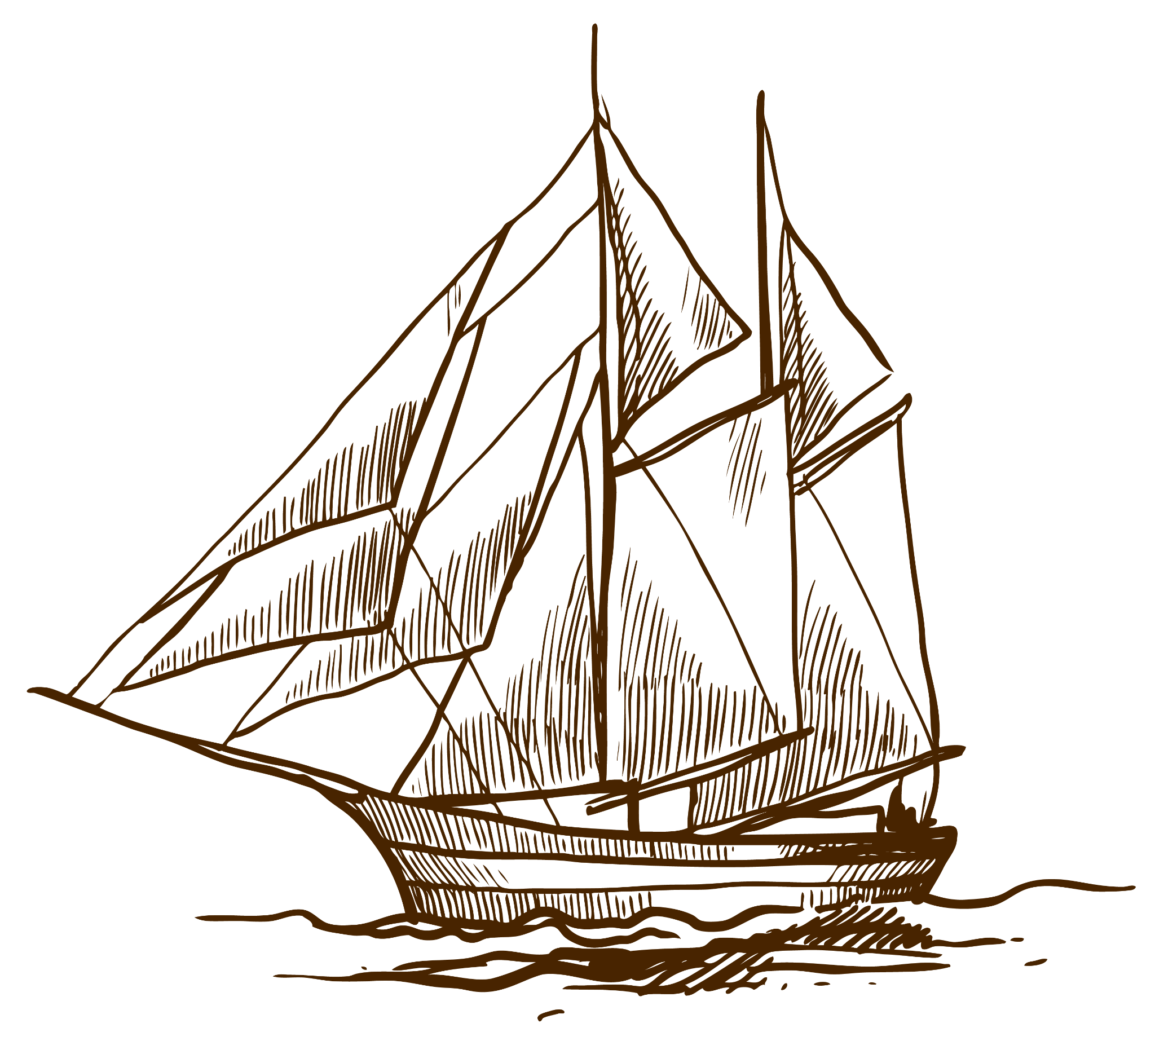
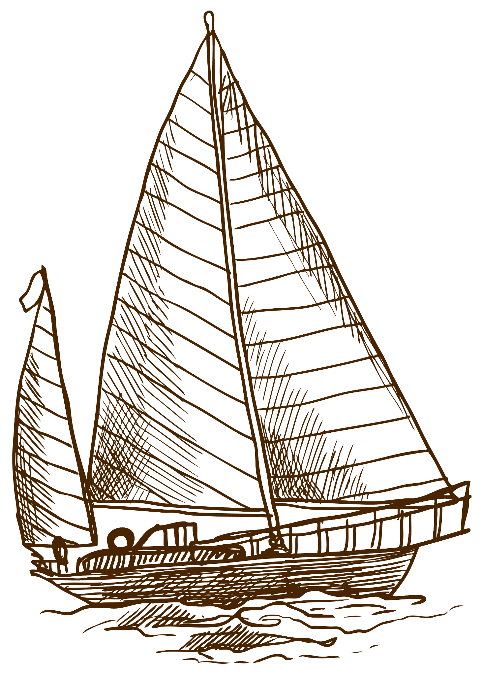
KEY LOCATIONS IN ORDER TO UNDERSTANDING HISTORY
MARS
SATURN
MERCURY
VENUS
NEPTUNE
SATURN

Slide 30
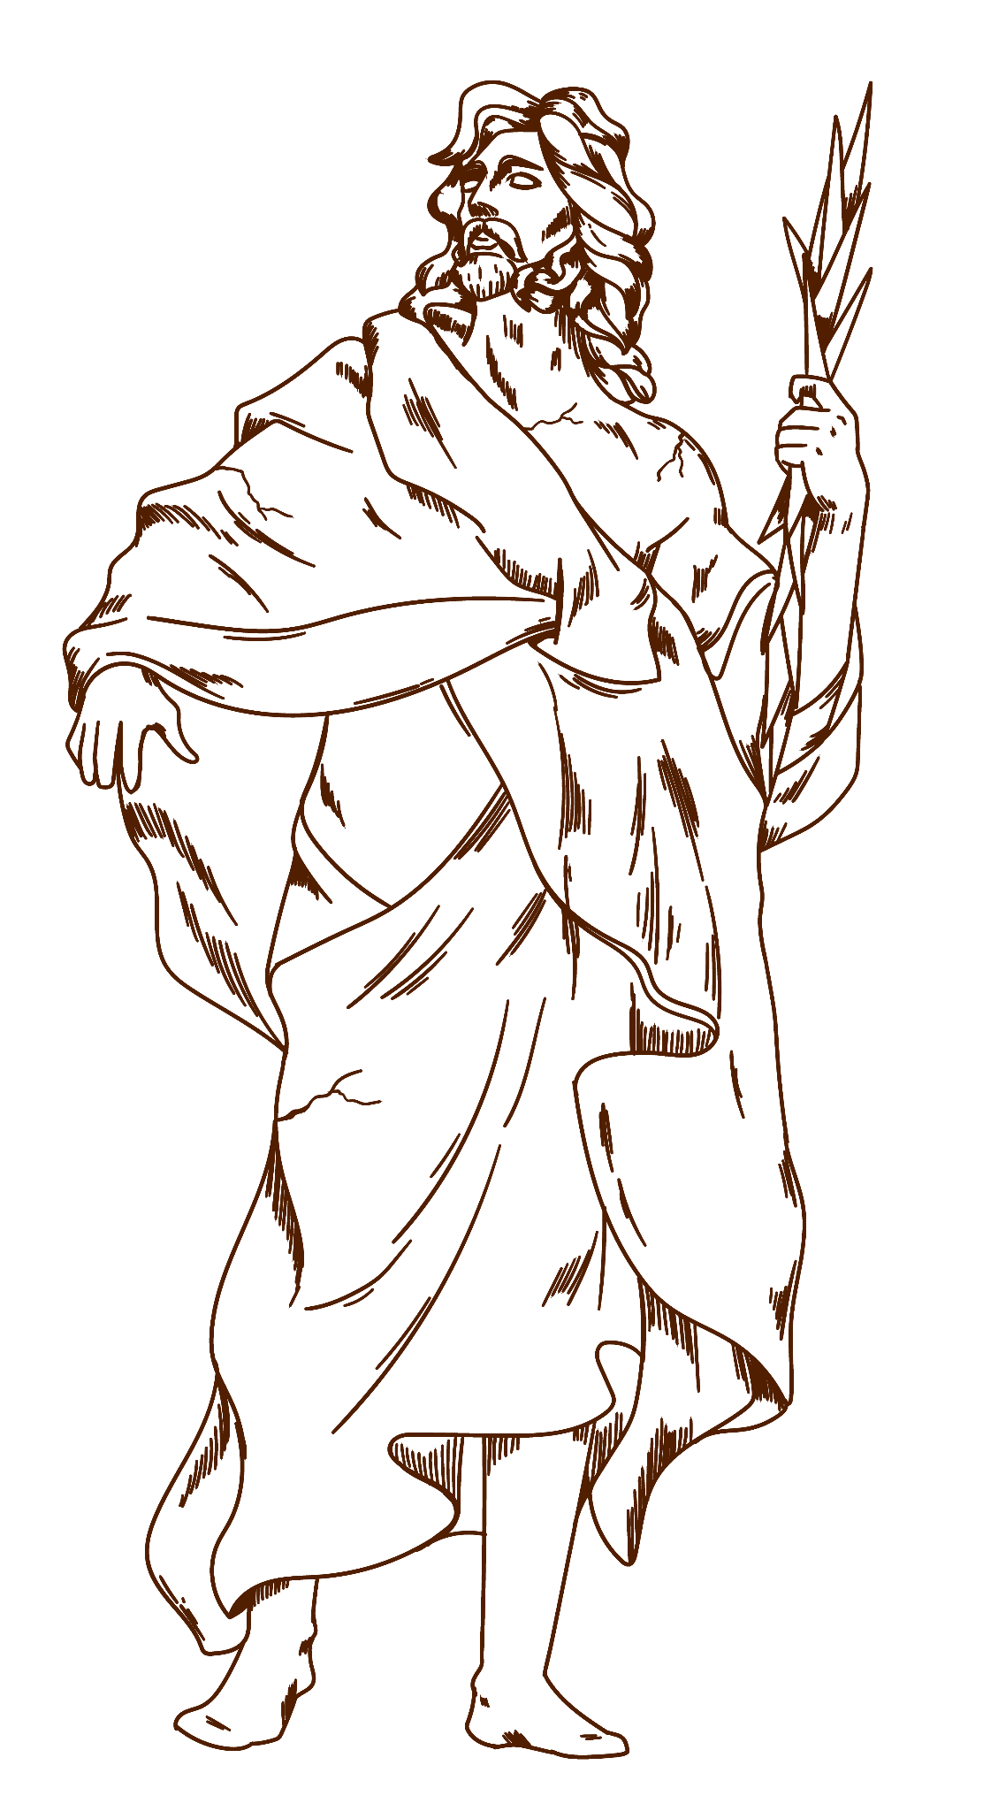
TYPES OF PAPYRUS
NEPTUNE
SATURN
JUPITER
MERCURY
MARS
VENUS
Neptune is the farthest planet from the Sun
Saturn is composed of hydrogen and helium
Jupiter is the biggest planet in the Solar System
Mercury is the closest planet to the Sun
Despite being red, Mars is actually a cold place
Venus is the second planet from the Sun

Slide 31
THE MANUFACTURING OF PAPYRUS
01
02
03
FIRST STEP
SECOND STEP
THIRD STEP
Despite being red, Mars is actually a cold place
Venus is the second planet from the Sun
Mercury is the closest planet to the Sun
SOME TIPS
SOME TIPS
SOME TIPS
Saturn has rings
Neptune is far away
Jupiter is huge
Mars is cold
Earth has life
Venus is very hot

Slide 32
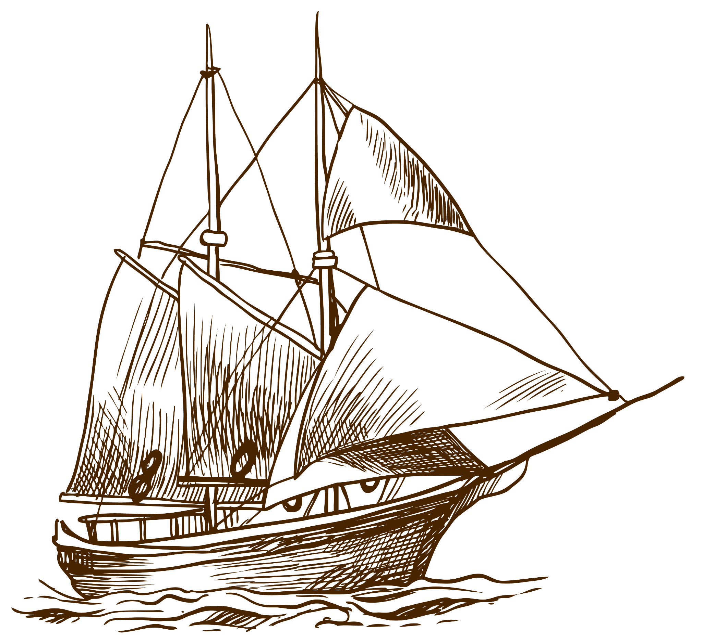
03
ASSIGNMENT
You can enter a subtitle here if you need it

Slide 33
YOU SHOULD KEEP THESE THINGS IN MIND
MERCURY
SATURN
VENUS
MARS
JUPITER
Mercury is the closest planet to the Sun
Saturn is a gas giant and has several rings
Venus is the second planet from the Sun
Despite being red, Mars is a cold place
It’s the biggest planet in the Solar System

Slide 34
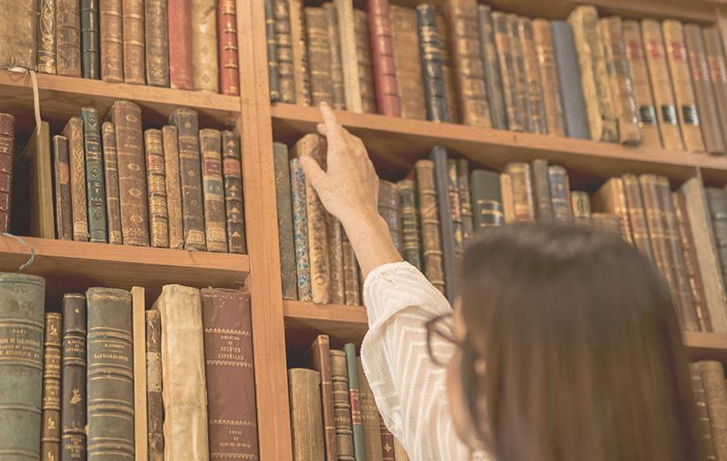
MULTIMEDIA
You can insert your own multimedia content here. It could be a nice addition to your lesson, making it more entertaining

Slide 35
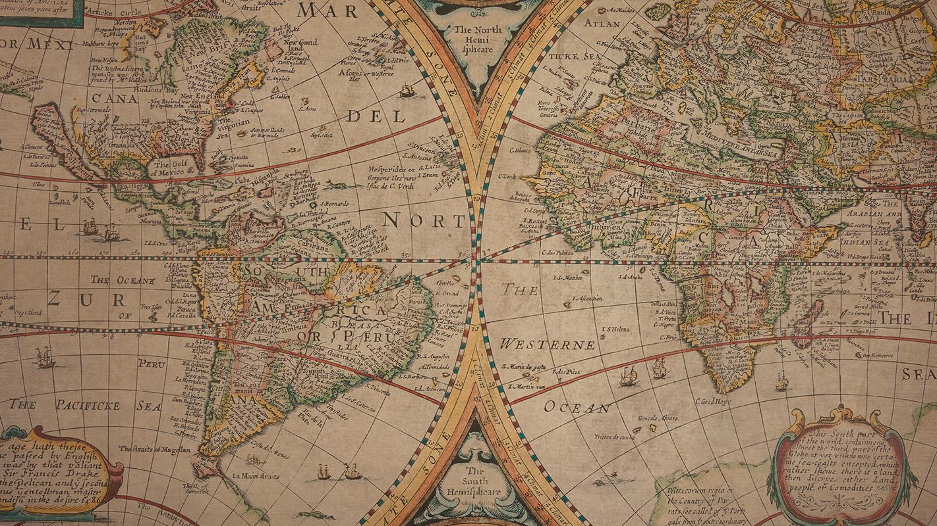
A PICTURE IS WORTH A THOUSAND WORDS

Slide 36
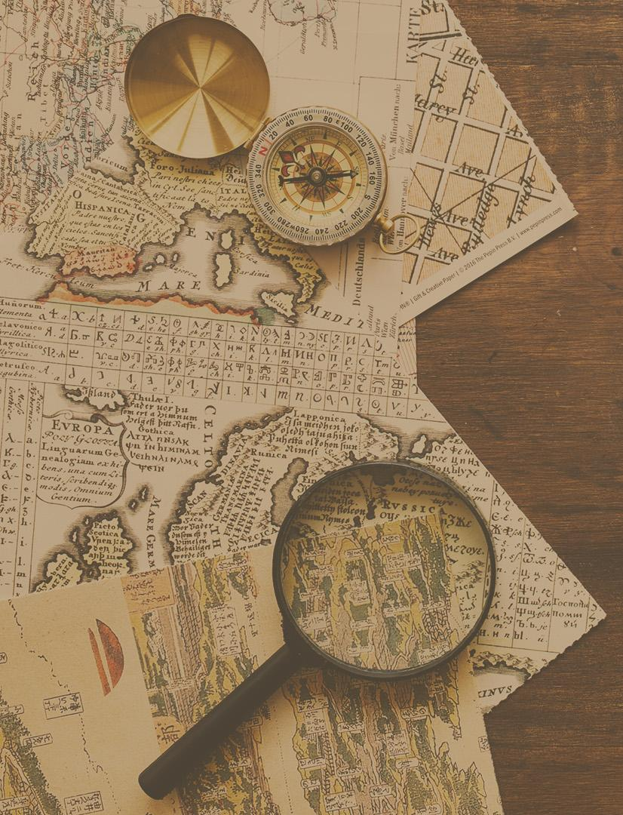
A PICTURE ALWAYS REINFORCES THE CONCEPT
Images reveal large amounts of data, so remember: use an image instead of a long text. Your audience will appreciate it

Slide 37
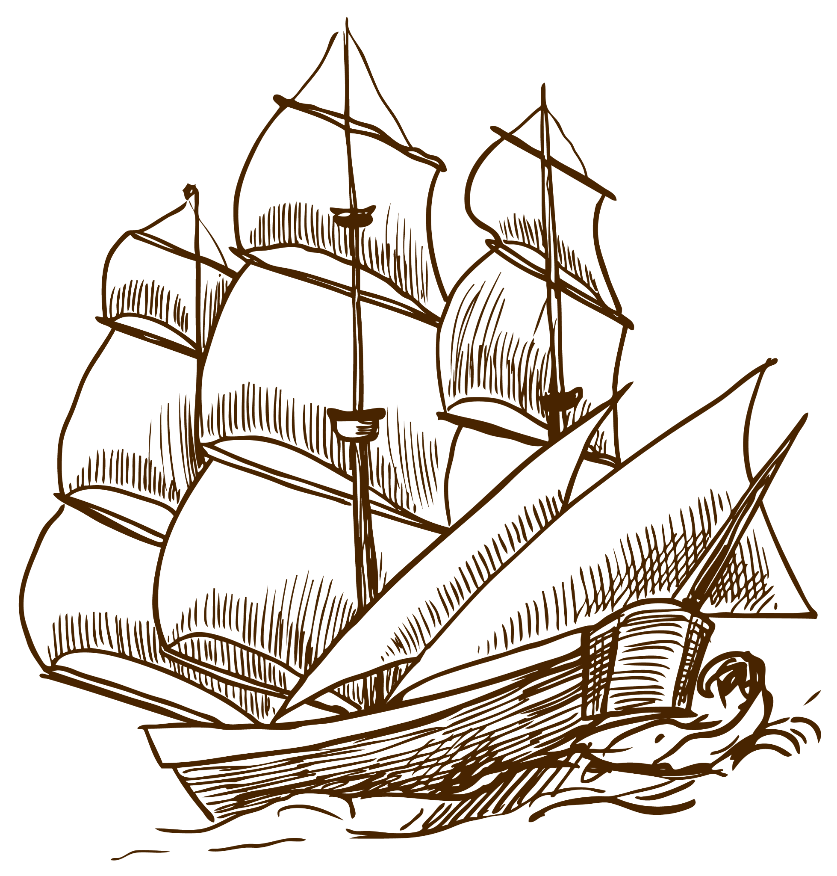
04
ABOUT THE TOPIC
You can enter a subtitle here if you need it

Slide 38
DISCUSSION
PAPYRUS DISCOVERY
ABOUT ITS USE
TRADITIONAL TECHNIQUE
Earth is the third planet from the Sun and the only one that harbors life in the Solar System. This is where we all live on
Mercury is very small
Venus is a hot planet
Jupiter is a gas giant
Saturn is a gas giant
Earth is the planet with life
Neptune is the farthest planet from the Sun. It's also the fourth-largest planet by diameter in the Solar System
Saturn is composed mostly of hydrogen and helium. It was named after the Roman god of wealth and agriculture

Slide 39
DID YOU KNOW THIS?
01
02
03
SATURN
NEPTUNE
VENUS
Yes, this is the ringed planet. It’s a gas giant, composed of hydrogen and helium
Neptune is the farthest planet from the Sun and the fourth-largest by diameter in the Solar System
It has a beautiful name and is the second planet from the Sun. It’s quite hot, even hotter than Mercury

Slide 40
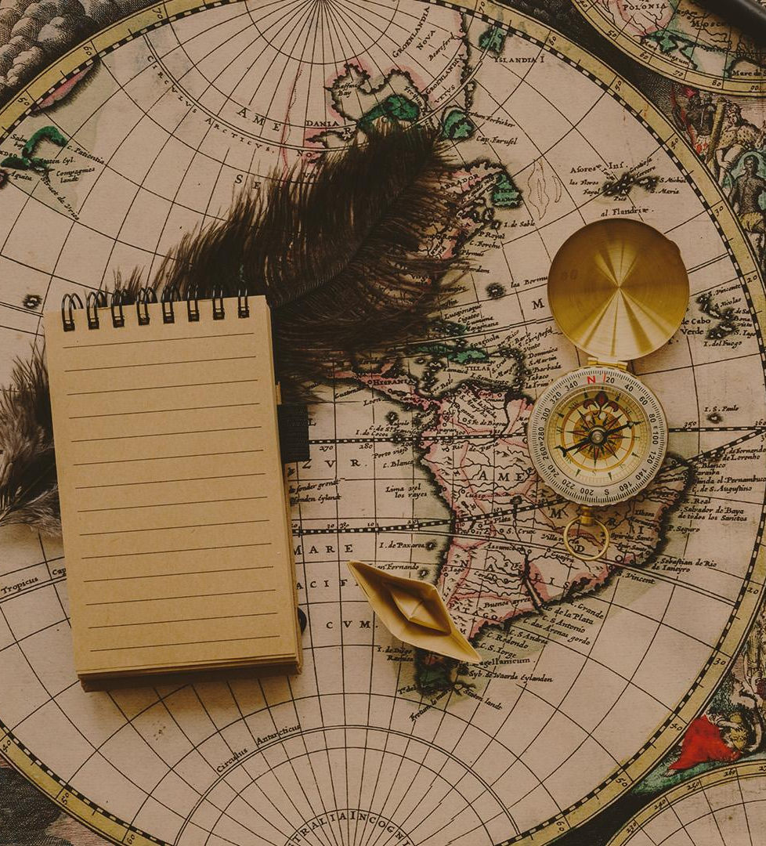
EGYPTIANS
MARS
EARTH
VENUS
Despite being red, Mars is actually a cold place
Earth is the beautiful planet where we all live on
Venus is extremely hot, even more than Mercury

Slide 41
PROBLEM
SOLUTION
Despite being red, Mars is actually a cold place. It’s full of iron oxide dust, which is what gives the planet its reddish cast
Venus has a beautiful name and is the second planet from the Sun. It’s hotter than Mercury, which is closer to the Sun

Slide 42
THIS IS A TABLE
 | 1350 | 1400 | 1450 | 1500 | 1550
VENUS | 123 | 444 | 321 | 235 | 452
MARS | 457 | 864 | 1000 | 567 | 678
JUPITER | 34 | 76 | 125 | 97 | 76

Slide 43
THE OLDEST WRITINGS
SHURUPPAK INSTRUCTIONS | 2600 BC | Mercury is the smallest planet of them all
TEMPLE OF KOSH | 2600 BC | Venus is extremely hot, even more than Mercury
URUKAGINA CODE | 2600 BC | Earth is the planet where we all live on
LEGEND OF ETANA | 2400 BC | Despite being red, Mars is actually a cold place
PYRAMID TEXTS | 2400 BC | Jupiter is the biggest planet of them all

Slide 44
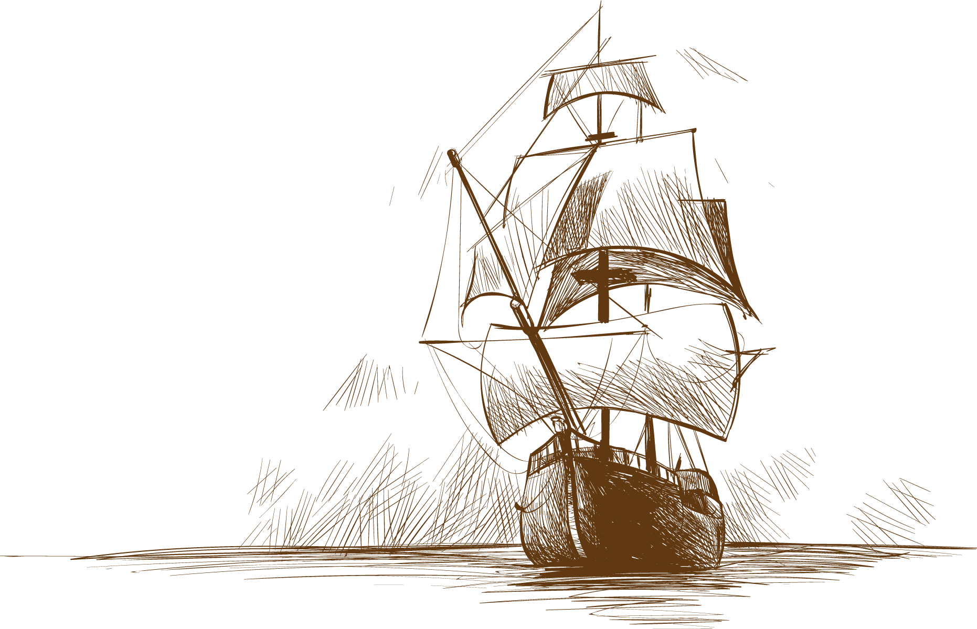
AWESOME WORDS

Slide 45
STUDY SCHEDULE
MON | TUE | WED | THU | FRI | SAT | SUN
01 | 02 | 03 | 04 | 05 | 06 | 07
08 | 09 | 10 | 11 | 12 | 13 | 14
15 | 16 | 17 | 18 | 19 | 20 | 21
22 | 23 | 24 | 25 | 26 | 27 | 28
29 | 30 | 31
MARS
MERCURY
VENUS
Despite being red, Mars is a cold place
Mercury is the closest planet to the Sun
Venus has extremely high temperatures

Slide 46
THE OLDEST PORTS IN THE WORLD
2.
1.
1.
2.
331 BC
450 BC
ALEXANDRIA
ATHENS
Saturn was named after a Roman god
Ceres is located in the asteroid belt

Slide 47
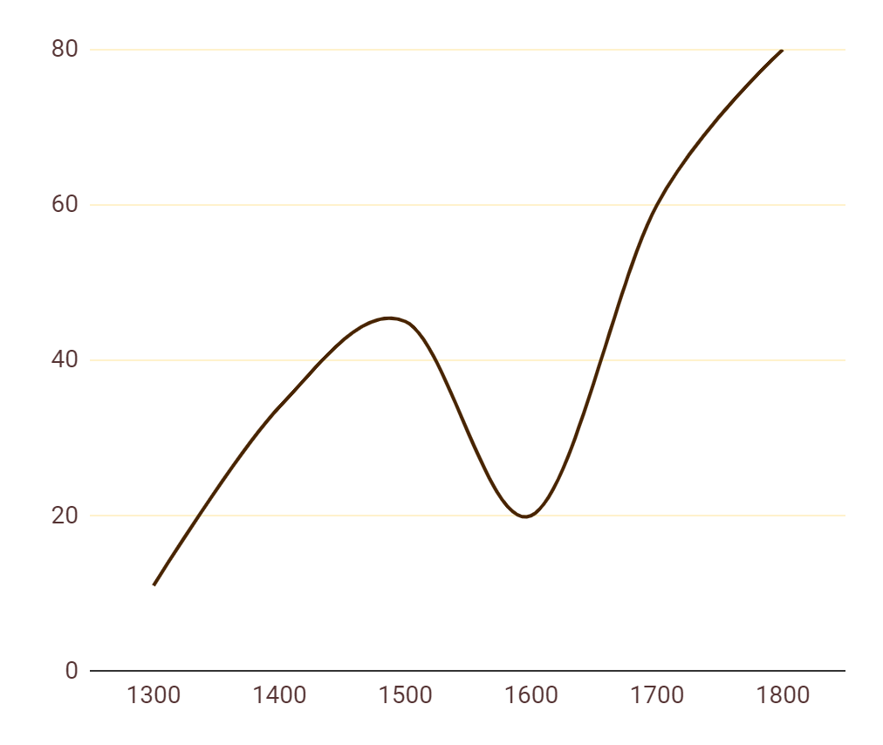
HISTORICAL DATA
VENUS
A
Venus is the second planet from the Sun
C
MARS
B
Despite being red, Mars is actually a cold place
B
A
JUPITER
C
It’s the biggest planet in the Solar System
If you want to modify this graph, click on it, follow the link, change the data and replace it here

Slide 48
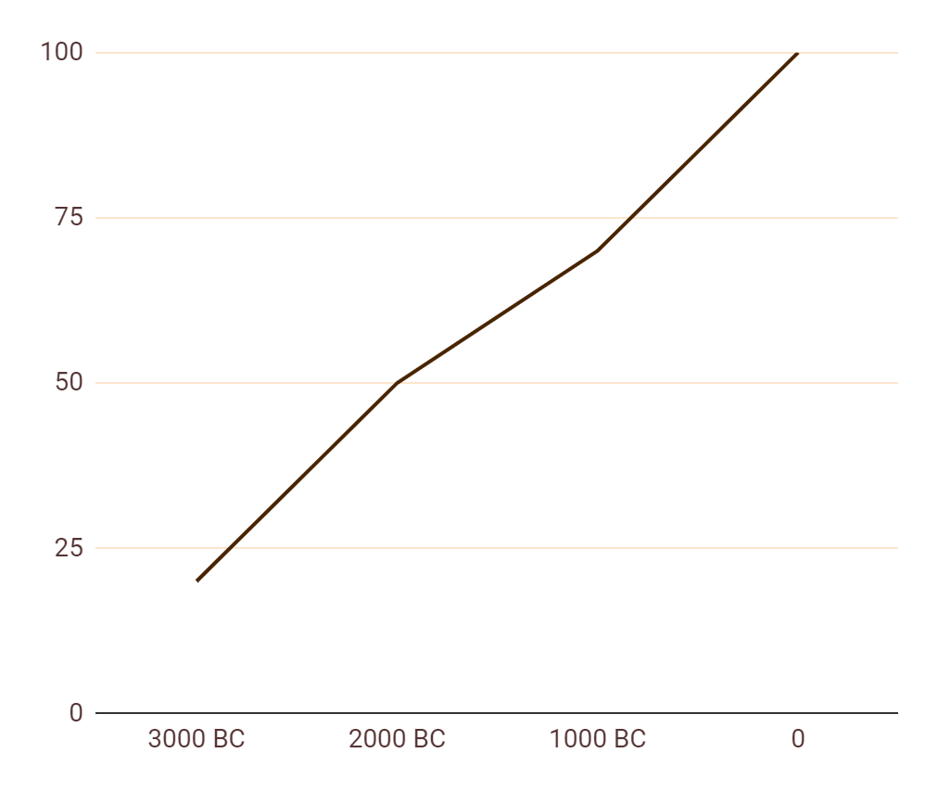
ANALYSIS AND DEVELOPMENT
3000 BC
1000 BC
Jupiter is the biggest planet of them all
Mercury is the closest planet to the Sun
20%
70%
2000 BC
0
Venus is the second planet from the Sun
Mars is actually a very cold place
50%
100%
* To modify this graph, click on it, follow the link, change the data and paste the new graph here, replacing this one.
You can see how to modify the graph here

Slide 49
PROCESS
Mercury is the closest planet to the Sun
Despite being red, Mars is actually a cold place
1390
MERCURY
1530
MARS
VENUS
1450
SATURN
1610
Venus is the second planet from the Sun
It’s composed of hydrogen and helium

Slide 50
THE ELABORATION PROCESS
1
2
3
JUPITER
MERCURY
PLUTO
Jupiter is the biggest planet of them all
It’s the closest planet to the Sun
It’s now considered a dwarf planet
VENUS
MARS
CERES
Venus is the second planet from the Sun
Mars is actually a very cold place
It’s located in the main asteroid belt

Slide 51
OVERVIEW DIAGRAM
VENUS
Venus has a beautiful name, but also high temperatures
MARS
JUPITER
SATURN
Despite being red, it’s actually a cold place
It’s the biggest planet in the Solar System
It’s composed of hydrogen and helium

Slide 52
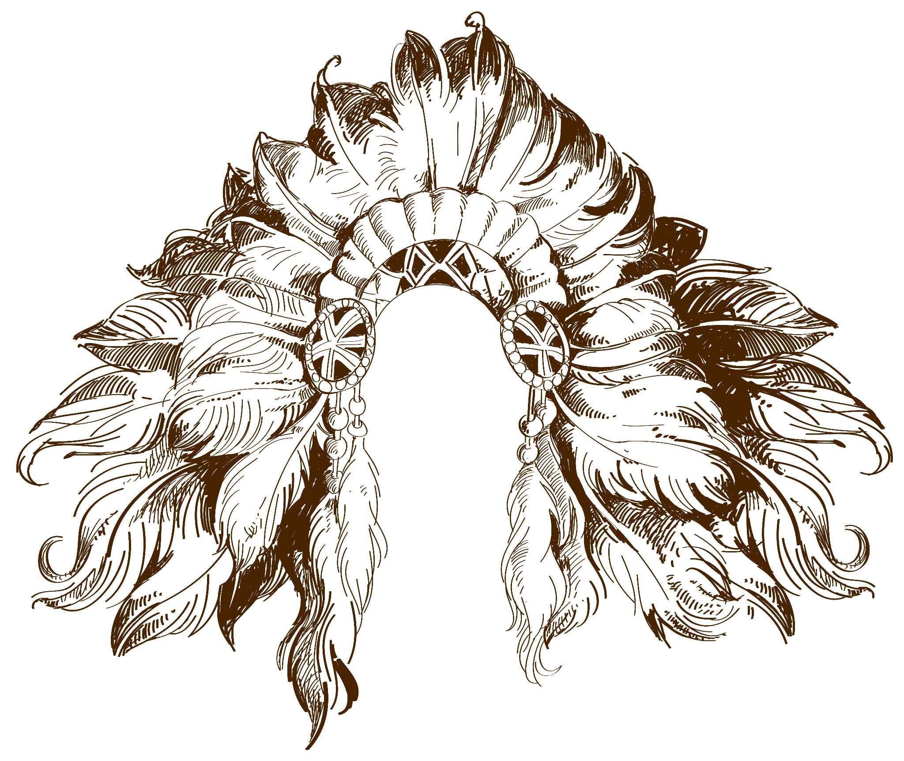
CONCLUSIONS
1.
2.
NEPTUNE
Neptune is the farthest planet from the Sun. It's also the fourth-largest by diameter in the Solar System
SATURN
It's composed mostly of hydrogen and helium. It was named after the Roman god of wealth and agriculture

Slide 53
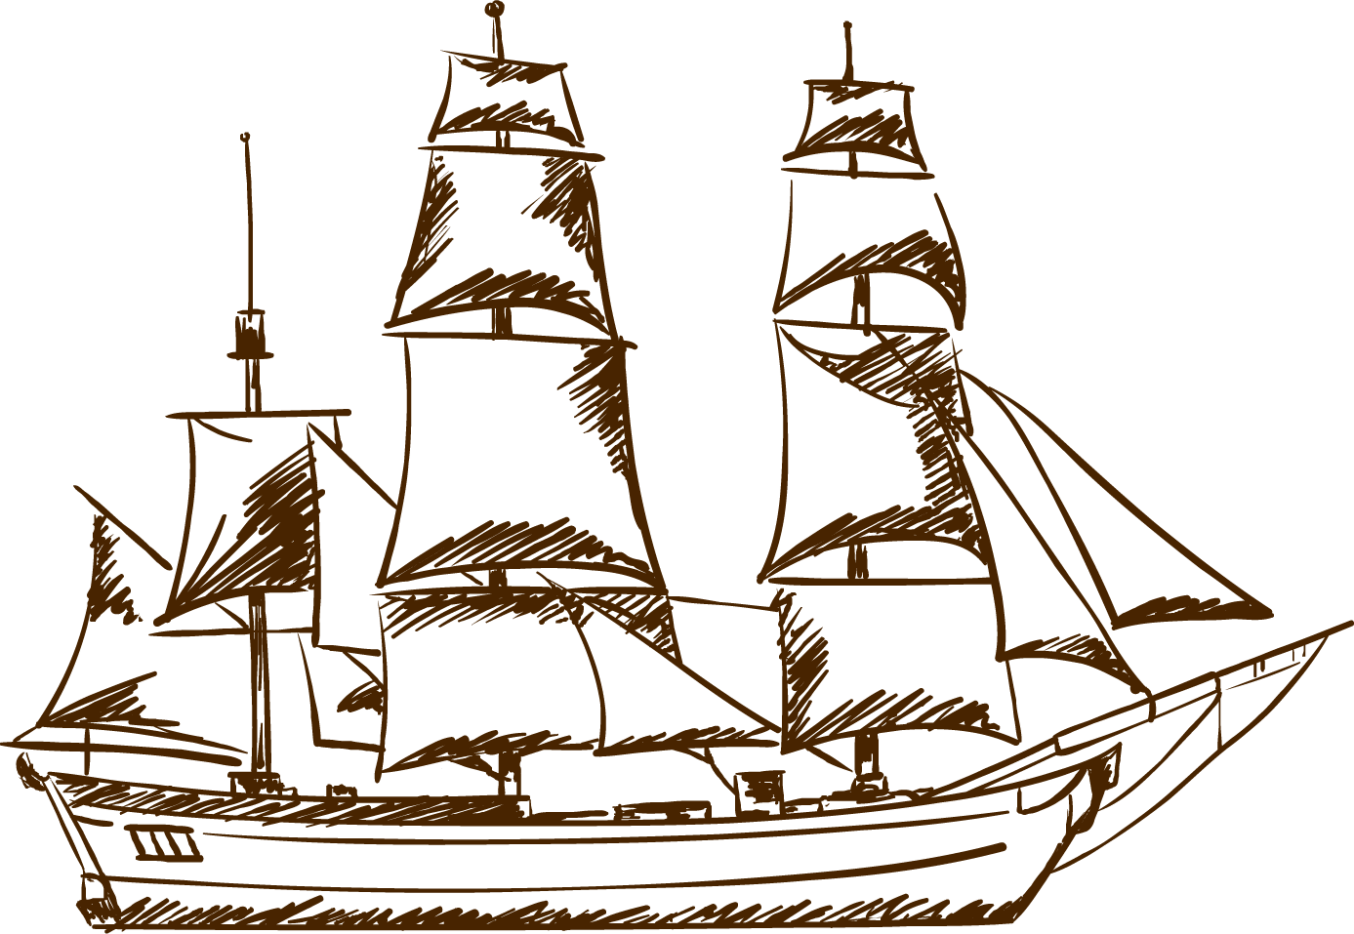
EXERCISE
Fill in the blanks with the name of each part
_____
_____
_____
Mercury is the smallest of them all
Despite being red, Mars is a cold place
Venus is the second planet from the Sun

Slide 54
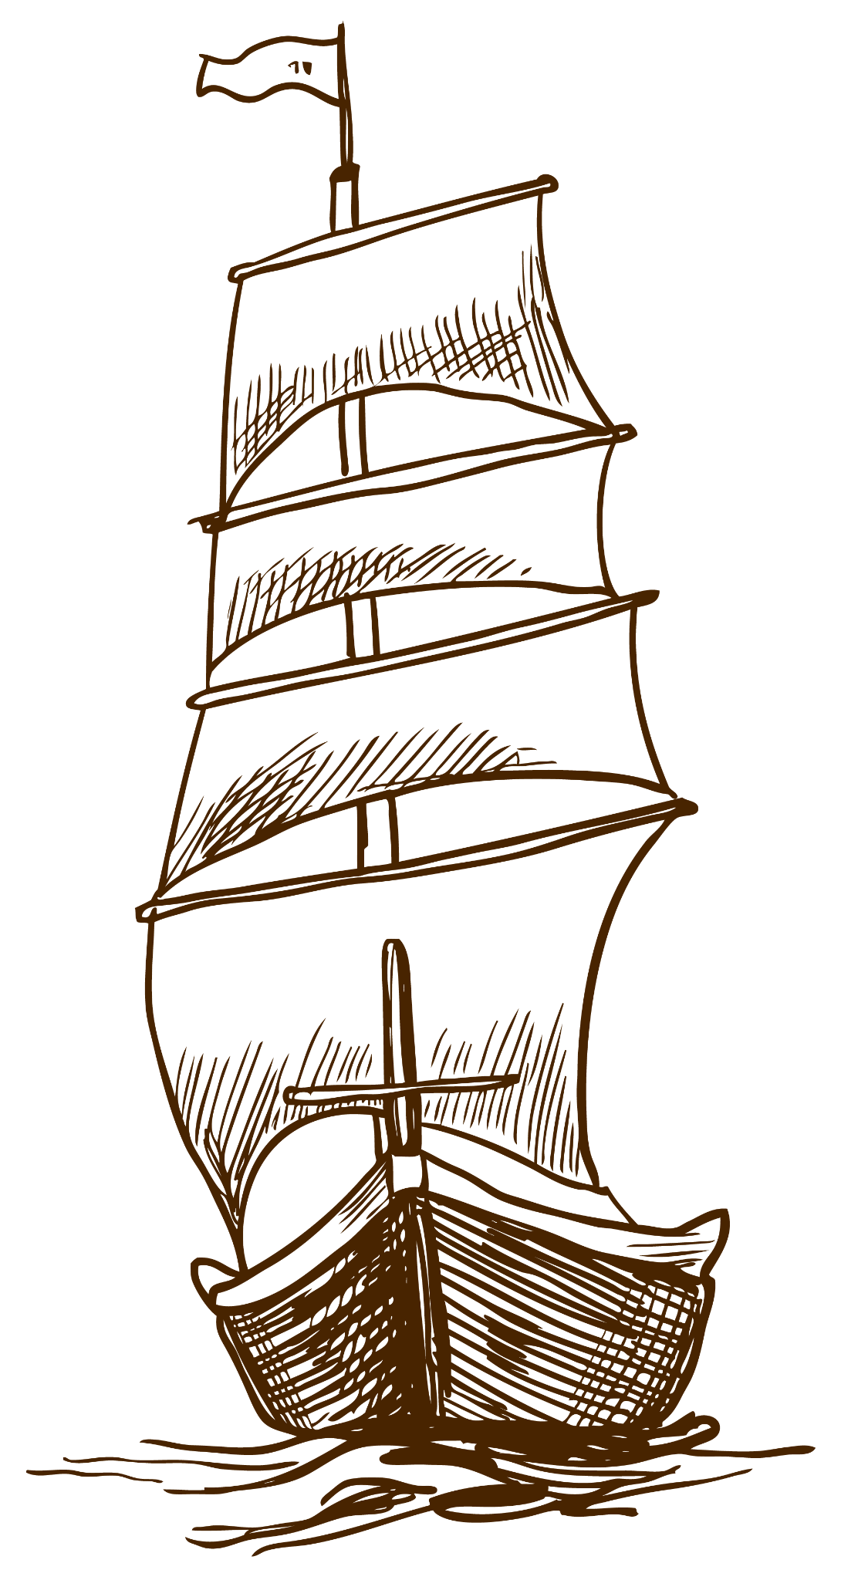
EXERCISE TWO
Which word belongs to each description?
_____
_____
This is Earth’s only natural satellite
This is the smallest planet of them all
_____
_____
This gas giant has several rings
It is located in the main asteroid belt
SATURN
MERCURY
MOON
CERES

Slide 55
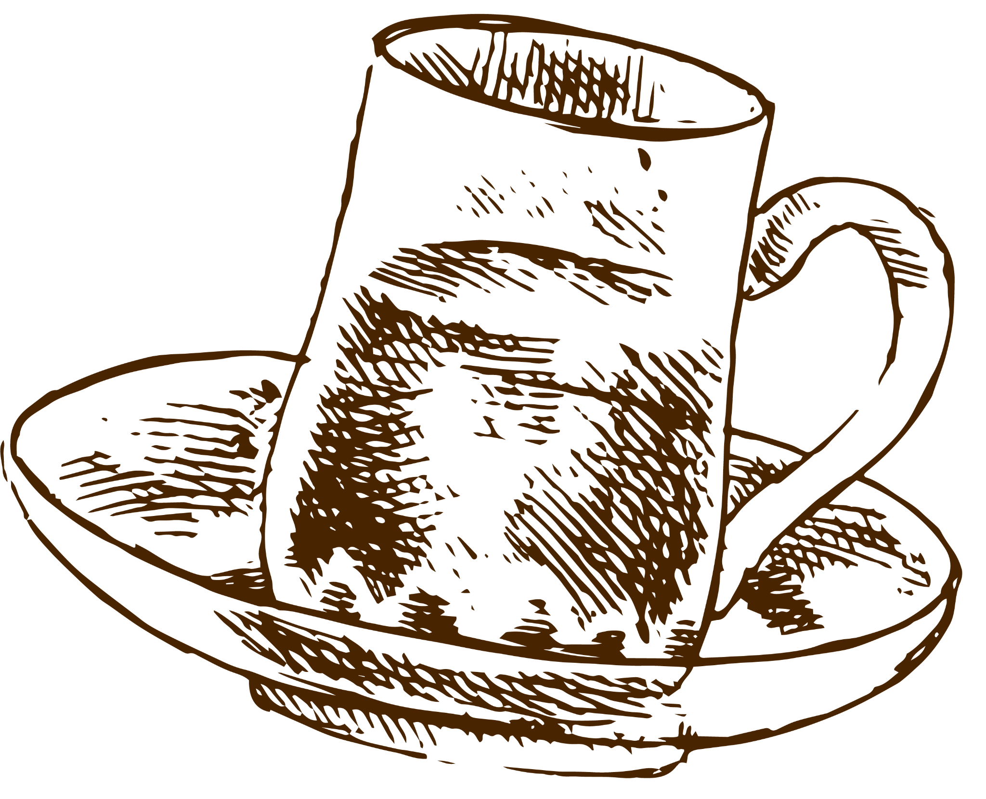
EXERCISE THREE
Match the sentences with words. Look at the example
NEPTUNE
It is the farthest planet from the Sun
SATURN
It is located in the main asteroid belt
MERCURY
It is the closest planet to the Sun
VENUS
It has extremely high temperatures
MARS
It is the only planet that harbors life
JUPITER
It is full of iron oxide dust
CERES
It is the biggest planet of them all
EARTH
It is a gas giant and has several rings

Slide 56
EXERCISE FOUR
Fill in the gaps the best word. Look at the first example
1
JUPITER
2
MERCURY
Jupiter is the _____ planet in the Solar System
Mercury is the closest planet _____the Sun
3
MARS
4
VENUS
Despite being red, Mars _____ actually a cold place
Venus has a beautiful name, _____ it’s quite hot
5
SATURN
6
NEPTUNE
Saturn is composed _____ hydrogen and helium
Neptune is the farthest _____ from the Sun

Slide 57
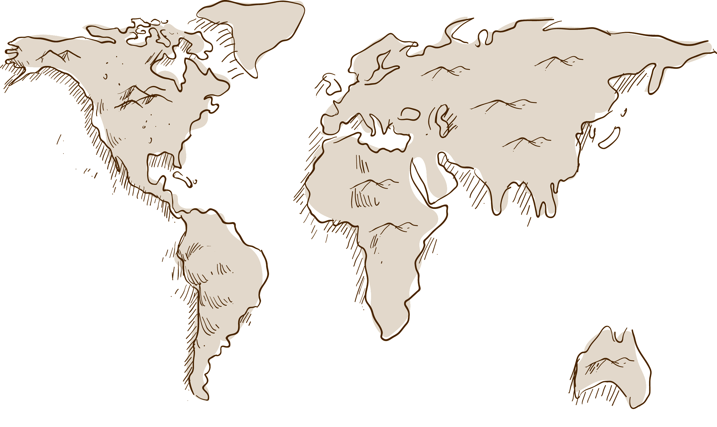
ASSIGNMENT
Venus is the second planet from the Sun
Mercury is the closest planet to the Sun
Despite being red, Mars is actually a cold place

Slide 58
METHODOLOGY
RESEARCH
ANALYSIS
STUDY
COMPARISON
Jupiter is the biggest planet in the Solar System
Mercury is the smallest planet in the Solar System
Earth is the beautiful planet where we all live on
Despite being red, Mars is actually a cold place

Slide 59
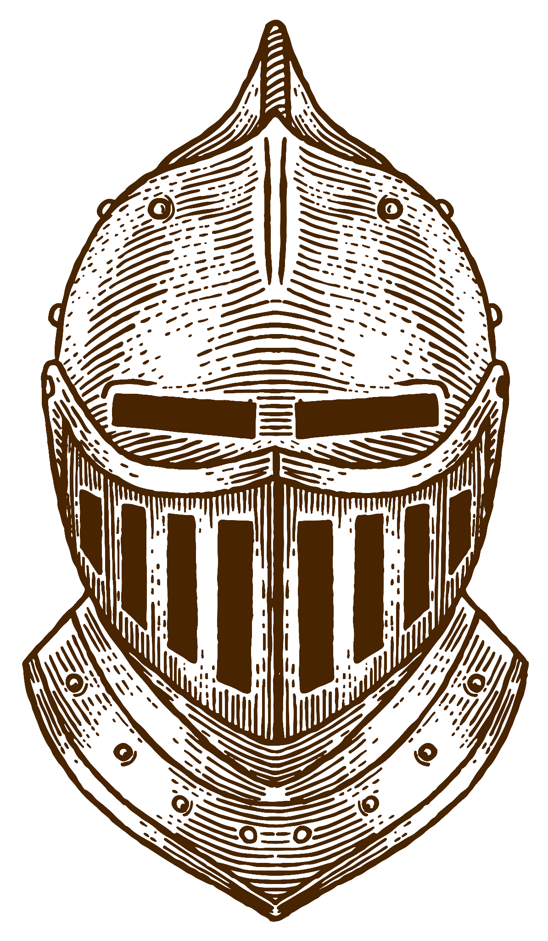
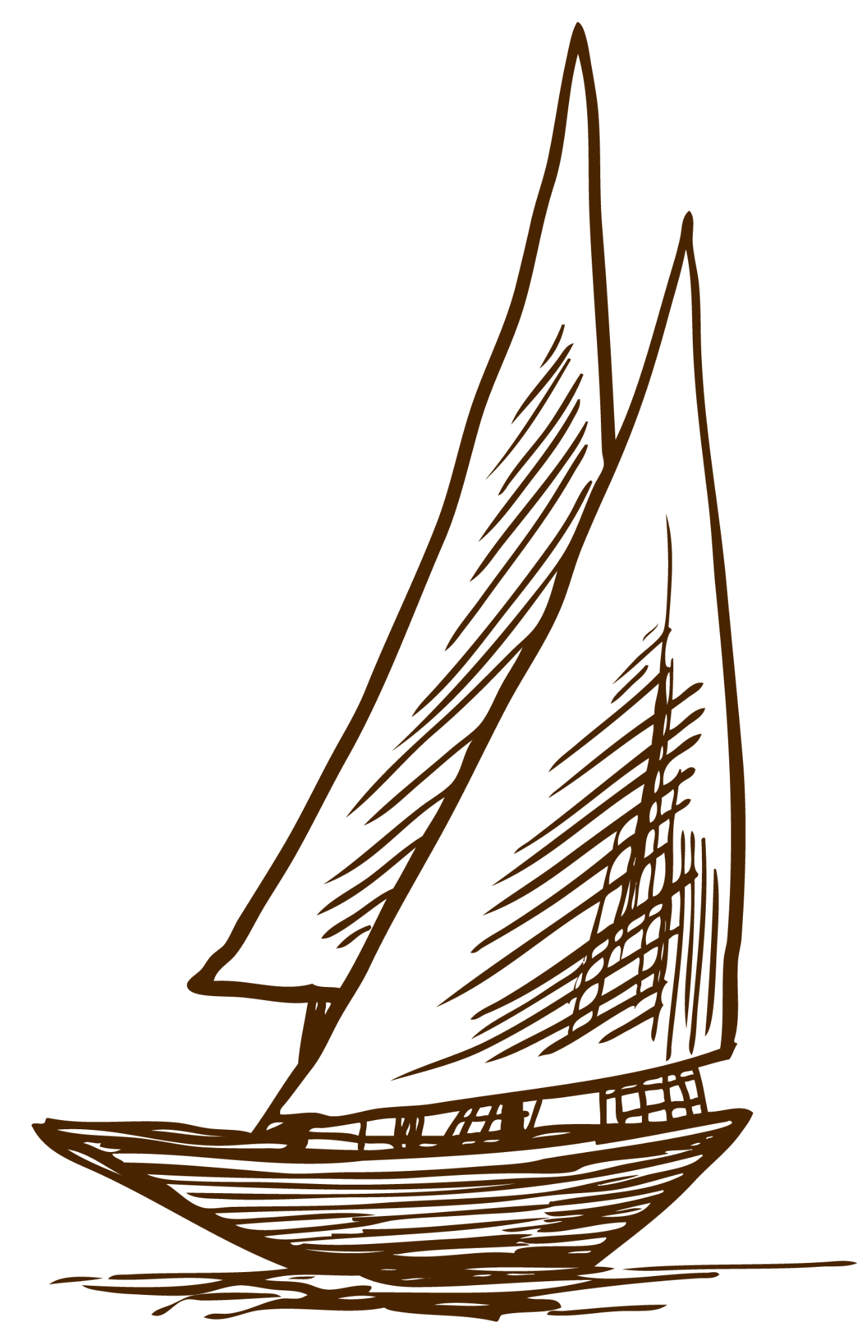
LITERATURE RECOMMENDATIONS
AUTHOR (YEAR). Title of the publication. Publisher
Mercury is the closest planet to the Sun
AUTHOR (YEAR). Title of the publication. Publisher
The Moon is Earth’s only natural satellite
AUTHOR (YEAR). Title of the publication. Publisher
Ceres is located in the main asteroid belt
AUTHOR (YEAR). Title of the publication. Publisher
Saturn is a gas giant and has several rings
AUTHOR (YEAR). Title of the publication. Publisher
Pluto is now considered a dwarf planet

Slide 60
RESOURCES
Did you like the resources on this template? Get them for free at our other websites.
VECTORS
Sketch background of elegant armor helmet
Sketchy pack of medieval elements
Hand drawn winter landscape background
Hand drawn world book day background
Hand drawn boat with waves background
Sketch of mountains with a path background
Hand-drawn collection of great boats
Background of fishing boat sailing
Sea background with hand drawn boat
Hand drawn lighthouse with boat and other sailor elements
Vintage hand drawn galleon background
Hand drawn egyptian gods and symbols collection
Ancient world map
Stacked books in hand drawn style
PHOTOS
Excellent female student choosing vintage book in library
High angle view of old historic map

